Slide 1

The genomics facilitator’s toolkit
NTGLH Module ID | Module Title | Module Format
NTGHL_001 | NHS Genomic Medicine Service | Handbook
NTGHL_002 | Ordering from the National Test Directory | Handbook
NTGHL_003 | Whole Genome Sequencing consent | Handbook
NTGHL_004 | Whole Genome Sequencing sample requirements | Handbook
NTGHL_005 | Clinical genetic testing methods | Powerpoint with narration
NTGHL_006 | Clinical testing DNA sequence variant interpretation | Powerpoint with narration
NTGHL_007 | Whole Genome Sequencing results | Powerpoint with narration
NTGHL_008 | Introduction to genomics | Powerpoint with narration
NTGHL_009 | Test cases in cancer | Handbook

Slide 2
NTGLH_004
Whole genome sequencing (WGS) sample requirements
Information for healthcare professionals
Notes:
Published 14/10/2020. Content is current at time of publication. Contact your GLH test provider for current GMS test forms.

Slide 3
Contents
Guidance documents
WGS sample requirements
Sample requirements - germline
Minimum blood volume requirements for germline WGS
Sample requirements - rare disease (RD)
Sample requirements - RD germline
Sample requirements - cancer
Sample requirements - cancer germline
Tumour sample requirements
Sample requirements - solid tumours
Sample requirements - haemonc. tumours
Sample prioritisation
Sample uses
Sample pathways
Advice and educational resources
Contacts and information
NTGLH004 – WGS sample requirements

Slide 4
Guidance documents
Four whole genome sequencing sample guidance documents have been published by NHS England for the Genomic Medicine Service, please refer to and/or ask your local GLH test provider for:
Sample Handling Guidance for Whole Genome Sequencing for Germline Samples
Sample Handling Guidance for Whole Genome Sequencing of Solid Tumour Samples
Sample Handling Guidance for Whole Genome Sequencing of Haematological Malignancies for Adults, Children and Young People
DNA Extraction and Quality Control Guidance for Whole Genome Sequencing.
NTGLH004 – WGS sample requirements

Slide 5
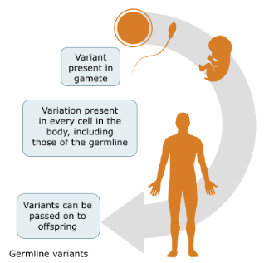
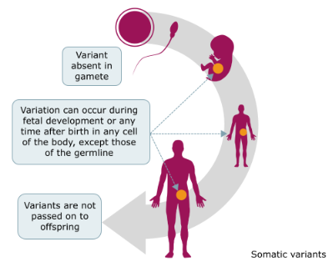
WGS sample requirements
Whole body: germline/constitutional
Tumour: acquired/somatic
Rare disease and cancer:
sourced from blood or tissue
Cancer only:
sourced from tumour sample
Rare disease and cancer germline samples, including all solid and liquid tumours, to be extracted by NTGLH are extracted at GOSH.
NTGLH004 – WGS sample requirements
Notes:
Genomics (and genetics) in rare disease or cancer affected patients can characterise DNA present in all cells of the body. Changes in the DNA here are termed as germline or constitutional variation. In cancer, DNA present in the cells of the tumour can also be characterised. Changes in the DNA here are termed as acquired or somatic variation.
Examples of source DNA:
1. Germline: Blood, saliva meeting certain criteria, fibroblast-derived DNA, uncultured skin biopsy or bone marrow aspirate meeting certain criteria
2. Somatic: tumour tissue sample including, fresh frozen tissue (not FFPE), bone marrow aspirate or peripheral blood meeting certain criteria.
Notes:
Saliva DNA can yield low quality DNA and testing has a higher sample failure rate. Submit in exceptional circumstances.
Participants who have had an allogenic bone marrow transplant (or in other atypical circumstances) should not have peripheral blood taken for DNA extraction. Instead use pre-bone marrow transplant stored DNA extracted from blood or DNA extracted from cultured fibroblasts.
Stored samples can be used but must meet criteria set out by Genomics England [see guidance documents listed above]
All North Thames GLH WGS test samples are to be sent for extraction to:
NORTH THAMES GENOMIC LABORATORY HUB
Great Ormond Street Hospital for Children NHS Foundation Trust
Specimen Reception, Level 5, Barclay House
37 Queen Square
London WC1N 3BH

Slide 6
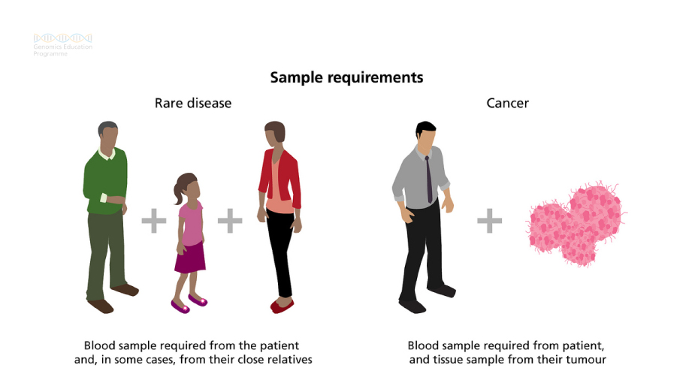
WGS sample requirements
NTGLH004 – WGS sample requirements
Notes:
Rare disease: Depending on the possible inheritance pattern and clinical indication, it is also important to include samples from other family members where possible. Please use the Test Selection Tool to determine the family structure that should be tested for each clinical indication - test-selection-private.beta.genomics.nhs.uk/test-selection/clinical-tests. Each family member submitting a sample for WGS will require consent see module, NTGLH003_Whole Genome Sequencing consent.
Cancer: In tumour sequencing, the sequence of the germline sample is subtracted from the sequence of the tumour sample. Dual sequencing allows clear differentiation between germline and somatic variants, aiding variant interpretation. Therefore, a tumour/normal matched sample pair is required for WGS to go ahead.
Where a contemporaneous germline and tumour sample are available, please send them to the GLH WGS test provider paired with the required paperwork. Pack these samples according to standard guidelines and send them via recorded/tracked delivery.
Where contemporaneous samples are not available then please send the tumour sample (and test order form). The tumour sample will be extracted and DNA will be stored for up to 40 days until the matched germline sample is available.

Slide 7
Sample requirements - germline
Germline DNA for WGS (and other genomic tests) are sourced from:
Ideally a peripheral blood sample
or alternatively sample
Saliva meeting certain criteria
Fibroblast-derived DNA
Uncultured skin biopsy
Bone marrow aspirate meeting certain criteria.
Refer to guidance for BMT or transfusion patients – NHS England’s, Sample Handling Guidance for Whole Genome Sequencing of Haematological Malignancies for Adults, Children and Young People.
NTGLH004 – WGS sample requirements
Notes:
Foetal tissue will not be accepted for WGS testing in rare disease.
For haematological disease blood and saliva may be contaminated with tumour cells, so cannot be used for germline characterisation in certain circumstances. The most appropriate alternative germline source will vary depending on the haematological tumour type and the clinical circumstance. Guidance on selection of suitable germline material for haematological cancers is provided in NHS England document - Sample Handling Guidance for Whole Genome Sequencing of Haematological Malignancies for Adults, Children and Young People. Contact your local GLH test provider for a copy.

Slide 8
Sample requirements - germline
Peripheral blood collected in an EDTA tube
Saliva - only in exceptional circumstances, according to kit guidelines
Cultured fibroblasts that must be collected, processed and stored according to local best practice and within a laboratory with UKAS ISO 15189:2012 accreditation for this process
Uncultured skin biopsy - 4mm punch biopsy
Bone marrow - tumour dependent
Stored DNA*
*Use of stored DNA must meet certain criteria, refer to NHS England WGS sampling handling guidance
NTGLH004 – WGS sample requirements
Notes:
See later slides for further specific WGS sample concentration input requirements.

Slide 9
Sample requirements - germline
To ensure successful WGS, a minimum amount of 2µg of DNA should be provided. This DNA requirement is sufficient for QC, WGS and potential future analysis
In exceptional circumstances only where limited sample is obtained, a minimum of 1μg of DNA can be submitted, but this will increase the likelihood of sample quality control (QC) failure
A further 5μg is recommended to be retained locally for follow-up if required.
NTGLH004 – WGS sample requirements
Notes:
Sourced from NHS England, DNA Extraction and Quality Control Guidance for Whole Genome Sequencing.
Further information: Two tubes, each filled with 3-5ml of blood, should be sufficient to meet the above quantities in the majority of patients. This can be modified based on local laboratory evidence. Age appropriate quantity discretion can apply. See NHS England, Sample Handling Guidance for Whole Genome Sequencing for Germline Samples. Contact your local GLH test provider for a copy.

Slide 10
Minimum blood volume requirements for germline WGS
In neonates, acutely ill children and other patients where venepuncture is challenging, clinical discretion should be applied to the volume of blood drawn.
Age | EDTA DNA
14 years+ | 3-5 ml x2
3-14 years | > 3ml x 2
0-3 years | 1-3 ml
NTGLH004 – WGS sample requirements

Slide 11
Sample requirements - rare disease (RD)
Only a germline sample is required
Where relevant sample from family members
If relevant family members are not present in the initial consultation, consent and samples may need to be arranged separately
The GLH will not send samples for sequencing until samples from all required members of the family (as noted on the WGS test order form) have been received.
NTGLH004 – WGS sample requirements
Notes:
In rare disease patients the sampling of family members may help with variant filtering and interpretation; a genome can contain up to five million variants when compared to a reference sequence. None, one or few variants identified by WGS may be disease causing in the context of the clinical indication tested for. For example, WGS may be requested to find the underlying cause of a condition in a child where neither parent has any of the same features. This means that variants that have arisen for the first time in the child (known as de novo variants) may be the cause of the condition. The genome of the average individual can contain up to 100 de novo single-nucleotide mutations. For more on variant interpretation see module, NTGLH006_Clinical testing DNA sequence variant interpretation. For more on inheritance models see module, NTGLH008_Introduction to genomics.
Therefore, WGS of a parent-proband trio maybe essential for certain gene-disease phenotypes. Please use the Test Selection Tool to determine the family structure that should be tested for each clinical indication - test-selection-private.beta.genomics.nhs.uk/test-selection/clinical-tests. To note, consenting family members may be carried out in a separate consultation, face-to-face or by telephone, depending on the clinical context.

Slide 12
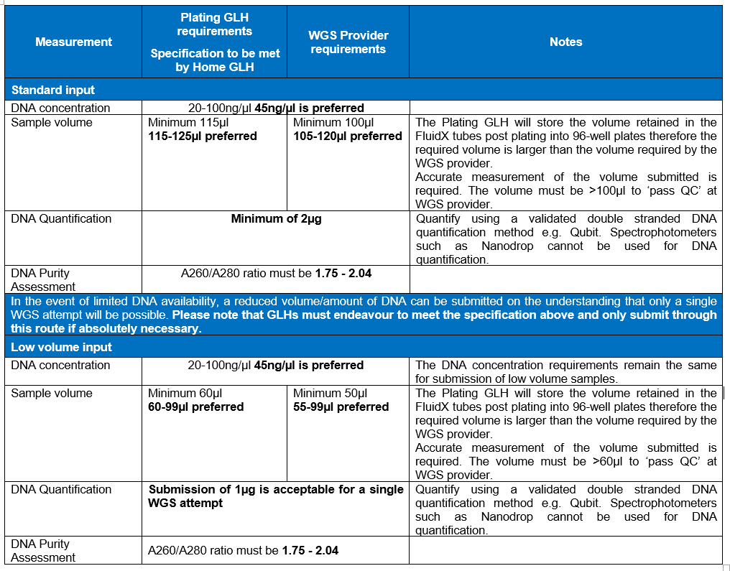
Sample requirements - RD germline
NTGLH004 – WGS sample requirements
Notes:
Slide sourced from, NHS England DNA Extraction and Quality Control Guidance for Whole Genome Sequencing v3.0
Germline DNA samples extracted for rare and inherited disease patients, and their family members, must meet the sample specification outlined above.
If the acquirement of sufficient DNA is not possible and a reduced amount of DNA in a reduced volume (see above) are submitted, this is on the understanding that there is an increased likelihood of no results being returned or partial WGS results are available due to the inability to repeat or rework the library preparation and/or WGS. Specific approval is not required for the submission of reduced DNA requirement samples, but this will be audited by NHS England.

Slide 13
Sample requirements - cancer
A tumour/normal matched pair is required for WGS to go ahead
For patients who have had a bone marrow transplant, a germline DNA sample would need to be acquired from fibroblasts, other unaffected tissue, or from a germline sample stored before the patient’s transplant
It can be more difficult to extract, sequence and obtain a high-quality result from DNA extracted from cancer cells of a solid tumour. Patients should be aware of the potential risk of sample failure and no results being obtained to provide information about their cancer
Conversely, for haematological malignancies (such as leukaemias), it can be more challenging to obtain a high-quality and uncontaminated germline sample
NTGLH004 – WGS sample requirements

Slide 14
Sample requirements - cancer germline
NTGLH004 – WGS sample requirements
Notes:
Slide sourced from, NHS England DNA Extraction and Quality Control Guidance for Whole Genome Sequencing v3.0. Germline DNA samples extracted for cancer patients must meet the sample specification outlined above.
If the acquirement of sufficient DNA is not possible and a reduced amount of DNA in a reduced volume (see above) are submitted, this is on the understanding that there is an increased likelihood of no results being returned or partial WGS results are available due to the inability to repeat or rework the library preparation and/or WGS. Specific approval is not required for the submission of reduced DNA requirement samples, but this will be audited by NHS England.
For some patients the tumour samples available are small or for haematological patients, the germline sample is limited, and may not yield a sufficient amount of DNA to meet even the reduced sample specification outlined in the above table. In such cases then any amount of DNA can be submitted for WGS but the minimum volume of 50µl must be submitted to the local WGS test provider to enable processing and sub-optimal WGS data may be returned to the submitting GLH test provider.

Slide 15
Tumour sample requirements
Specific guidance on selecting, sampling and storing tumour tissue for WGS is available.
Content Tumour Assessment:
For solid tumour invasive malignant nuclei must account for at least 30% of the nuclei present in the tissue sample submitted for WGS. Additionally, the sample should have less than 20% necrosis by area.
Specific guidance has been issued on haematological malignancies e.g. for AML, blood containing >=20% blasts morphologically or any blast percentage if there is an AML-defining genetic abnormality.
Tumour sampling techniques:
https://www.genomicsengland.co.uk/about-genomics-england/the-100000-genomes-project/information-for-gmc-staff/cancer-programme/pathology-in-the-nhs/
NTGLH004 – WGS sample requirements
Notes:
For tumour requirements, use the appropriate guidance:
Sample Handling Guidance for Whole Genome Sequencing of Solid Tumour Samples
Sample Handling Guidance for Whole Genome Sequencing of Haematological Malignancies for Adults, Children and Young People.

Slide 16
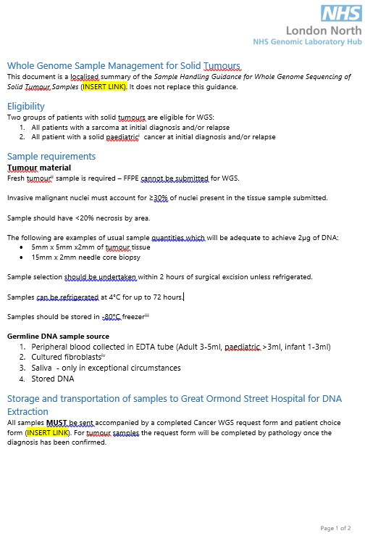
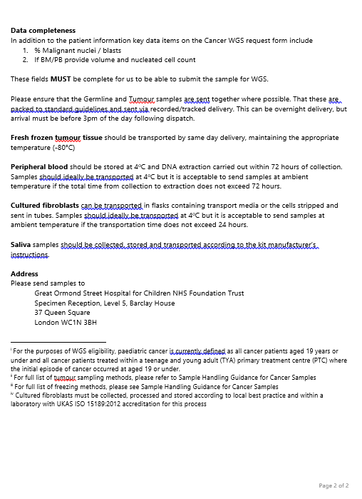
Sample requirements - solid tumours
NTGLH004 – WGS sample requirements
Notes:
Using knowledge at the time of publication of this handbook, The North Thames GLH has produced sample handling summary documents. Please contact the North Thames GLH for a copy.

Slide 17
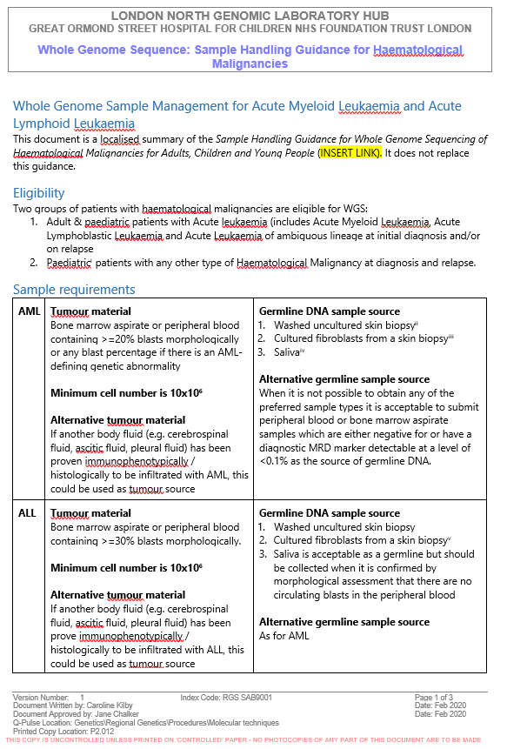
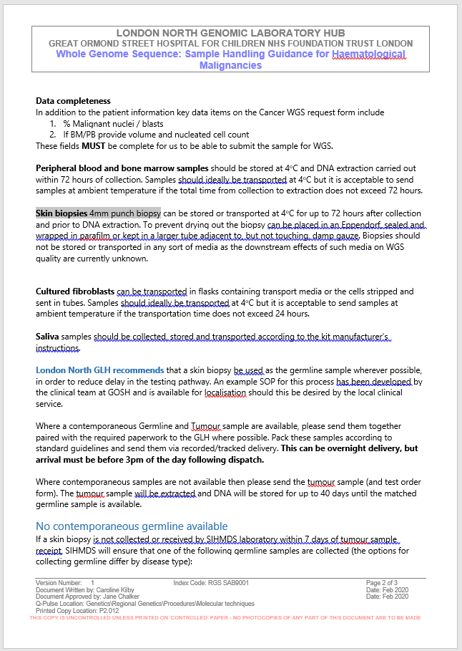
Sample requirements - haemonc. tumours
Notes:
Using knowledge at the time of publication of this handbook, The North Thames GLH has produced sample handling summary documents. Please contact the North Thames GLH for a copy.

Slide 18
Sample prioritisation
Until WGS bioinformatics pipelines are fully validated and results can be returned in an appropriate time frame, it will be necessary to run the assay in parallel with current standard of care testing (SOC).
Consequently, there will be occasions when there will not be sufficient material for all indicated tests. In this scenario priority should be given to those tests that will inform immediate management at the discretion of the treating clinician.
NTGLH004 – WGS sample requirements

Slide 19
Sample uses
Testing:
The GLH WGS DNA extraction laboratory will carry out checks to ensure quality of the samples. The laboratory for the WGS test request that has been raised, will await samples from all family members, tumour/normal matched pair, prior to sending them for sequencing.
A GLH WGS test provider will make contact if there are any issues with samples when they arrive at the laboratory, or if potential errors are identified at the time of sequencing or analysis.
NTGLH004 – WGS sample requirements
Notes:
For more information on sample uses see module, NTGLH007_Whole Genome Sequencing results.

Slide 20
Sample uses
Storage:
DNA samples are stored in the local GLH and can be accessed by other laboratories within the GMS. Tumour samples may also be stored in the local hospital histopathology unit.
Stored samples can be used:
In the future for further genomic tests provided appropriate consent has been obtained
As a control sample when testing family members of a proband
To help with laboratory test development and quality control procedures, although they are de-identified for this use.
The laboratory will notify the clinician if there is a limited remaining amount of sample (for instance, if an individual is deceased) so a decision can be made on how it can be used.
NTGLH004 – WGS sample requirements

Slide 21
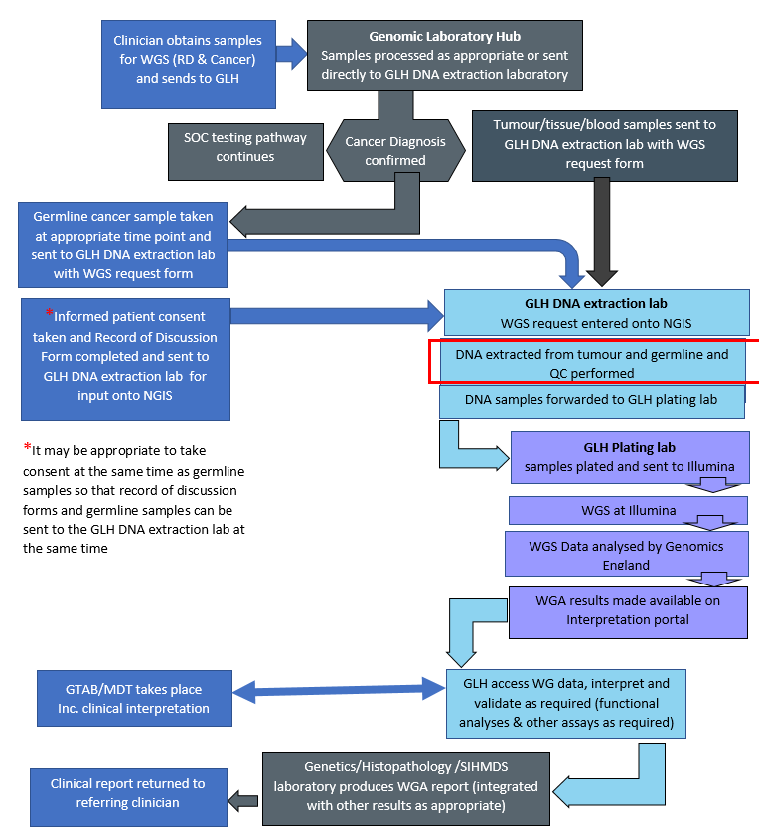
Sample pathway for rare and inherited diseases
NTGLH004 – WGS sample requirements
Notes:
Red box refers to steps considered in the NHS England DNA Extraction and Quality Control Guidance for Whole Genome Sequencing v3.0.

Slide 22
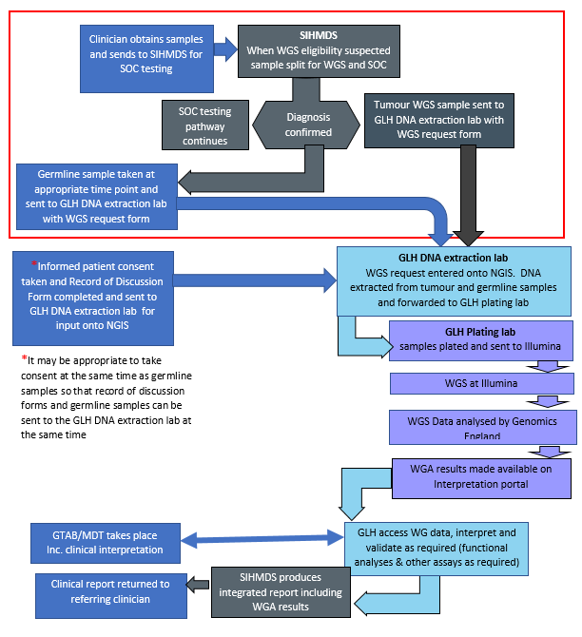
Sample pathway - haematological malignancies
NTGLH004 – WGS sample requirements
Notes:
Red box refers to steps considered in the NHS England Sample Handling Guidance for Whole Genome Sequencing of Haematological Malignancies for Adults, Children and Young People v3.0.

Slide 23
Advice and educational resources
North Thames Genomic Laboratory Hub
Follow us: @NorthThamesGLH
Contact us at: gos-tr.norththamesglh@nhs.net
Further education
https://www.genomicseducation.hee.nhs.uk/
Free online course -5 weeks, 2 hours per week
https://www.genome.gov/about-genomics/fact-sheets
https://www.futurelearn.com/courses/the-genomics-era
https://geneticsunzipped.com/blog/2019/3/4/008-getting-ready-for-genomic-medicine

Slide 24

Contacts and information
Primary author:
Shazia Mahamdallie, Scientist, GOSH
Content of slides have been adapted from NHS England WGS sample handing guidance, see document list on slide 4.
For any queries please contact:
North Thames GLH Education & Training Lead: Corinne Trim
corinne.trim@gosh.nhs.uk
Francesca Faravelli, Consultant Clinical Geneticist
Francesca.Faravelli@gosh.nhs.uk
Notes:
Published 14/10/2020. Content is current at time of publication. Contact your GLH test provider for current GMS test forms.

