Slide 1

Liquid Biopsy Biomarker Test Report: walkthrough video
Example using Marsden360 reports from a lung cancer cell-free circulating DNA sample.
This is a narrated deck. To listen, hover over the speaker icon at the bottom left of each slide and press play.
Additional information and links to resources are given in the note sections.
The contents of this video is correct at time of release, Sept 2024.
Notes:
For more information on terminology used in this video:
See NHS England, Genomics Education Programme – genomics glossary - https://www.genomicseducation.hee.nhs.uk/glossary/
Transcript:
Welcome to our video on liquid biopsy biomarker tests for cancer detection and genetic profiling

Slide 2
Contents
Introduction………………………………………………………………………………….3
Report variant detected - summary.…………………………….………………..4
Report variant detected - treatment options…….…………………………..7
Report variant detected - clinical trials…………………………………………..8
Report list of variants detected……………..……………………………………….9
Report information……………………………………………………………………….10
Report germline variant detected…………………………………………………12
Report no variant detected…………………………………………………………..13

Slide 3
Introduction
Welcome to our video on liquid biopsy biomarker tests for cancer detection and genetic profiling. These tests use cell-free DNA (cfDNA) from blood samples to identify genetic changes in circulating tumour DNA (ctDNA); a specific subset of cfDNA that comes from cancer cells.
We'll explain, using the Marsden360 test as an example, detects cancer-related genetic alterations (“variants") and guide you through the different test reports to understand treatment options and prognosis.
Notes:
For more information see:
(1) Circulating tumour DNA for cancer patients - https://www.genomicseducation.hee.nhs.uk/genotes/knowledge-hub/circulating-tumour-dna-for-cancer-patients/
Circulating tumour DNA is a subset of cell free DNA, which is double-stranded DNA released into the bloodstream from cells undergoing cell death or dividing. Circulating tumour DNA is commonly taken as a liquid biopsy to investigate a cancer. At present, the most common liquid biopsy in clinical practice and research is circulating tumour DNA from the peripheral blood.
(2) Variant - https://www.genomicseducation.hee.nhs.uk/genotes/knowledge-hub/variant/
A variant is any difference between the DNA sequence of two individuals’ genomes or a reference genome. Variants can be harmless or disease-causing (pathogenic).
(3) Marsden360 - https://www.royalmarsden.nhs.uk/marsden360
Transcript:
Liquid biopsy tests use cell-free DNA or cfDNA from blood samples to identify genetic changes. cfDNA are DNA fragments in the bloodstream from normal cell activity or various bodily processes. Circulating tumour DNA (ctDNA) is a subset of cfDNA that comes specifically from cancer cells. While cfDNA comes from all cell types, ctDNA is from tumour cells only. Tests like Marsden360 use this method to detect, profile, and monitor cancer.
In this video, we will walk you through the information found in a typical liquid biomarker test report from lung cancer patients. The Marsden360 test, is the example we will show. Other assay test reports such as the Foundation Medicine report may differ in look and format, but the core information reported will be similar.
The Marsden360 test is a gene panel test targeting specific genes. It detects cancer-related genetic alterations in ctDNA from a blood sample. Identifying these genetic alterations called variants, helps with treatment decisions and prognosis. Laboratory clinical scientists interpret the results to help guide personalised treatment options.
We will show examples of different reports types, discuss the significance of the detected variants, and explain the impact and limitations of this diagnostic tool on patient care.

Slide 4
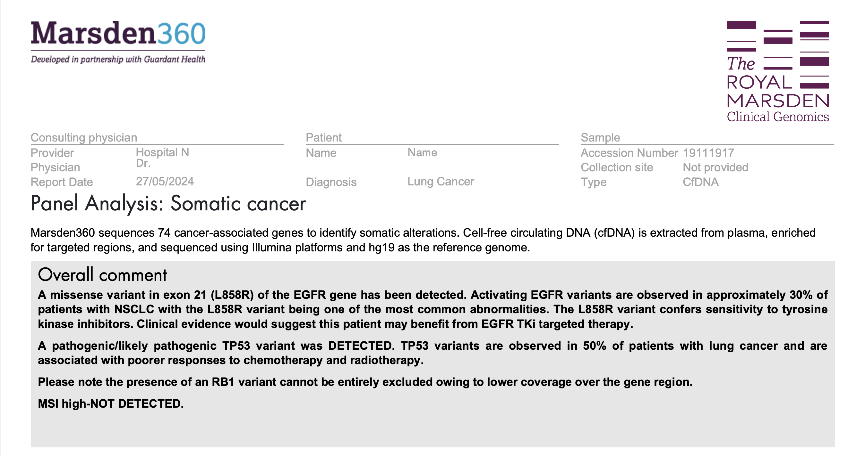
Liquid biopsy biomarker report – variant detected
Notes:
For more information see:
Pathogenic - https://www.genomicseducation.hee.nhs.uk/glossary/pathogenic/
Pathogenic can refer to anything that causes disease. This includes genomic variants and microorganisms such as viruses. A genomic variant is termed pathogenic if there is a direct link between the change and a particular condition or syndrome. Not all genomic variants and microorganisms are pathogenic, so it can take a lot of work to determine pathogenicity. Once this has been achieved it is possible to prescribe appropriate treatment.
(2) Mismatch repair deficiency and microsatellite instability - https://www.genomicseducation.hee.nhs.uk/genotes/knowledge-hub/mismatch-repair-deficiency-and-microsatellite-instability/
Microsatellites are repetitive DNA sequences. A defective MMR pathway means that errors within microsatellites are unrepaired, which may alter the length of the microsatellite, leading to MSI. MSI can be assessed by examining repeat sizes of select microsatellite markers using next-generation technologies. Tumours may be defined as MSI-high (MSI-H) (instability across multiple markers) or MSI-low (MSI-L) (instability at one marker only).
Transcript:
Typically, the first page of a test report summarises the clinically relevant variants identified. Variants detected by the test are classified based on current guidelines to provide information on the pathogenicity and actionability of a variant. At the top of the page is the overall comment section that is a summary of the results and the clinical scientists’ interpretation of the clinically relevant variants detected. The Marsden360 test also assesses microsatellite instability, or MSI for short, and indicates whether MSI-High, in other words, a high amount of instability in the tumour was detected or not. This is also reported in the overall comment section.
You’ll also notice in this overall comment section, a comment regarding RB1 gene status. In this scenario, RB1 status is given as patients with EGFR positive non-small cell lung cancer who harbour pathogenic variants in both TP53 and RB1 identify a subset of patients at increased risk for small cell transformation. No variant was detected in RB1 in this patient’s sample, or it would have been listed in the following analysis results section. However, it can’t be assumed as RB1 wild type as discrepancies are expected between cfDNA and tissue biopsy results, and I will touch on some of the explanations for this when I reach that section of the report and that will explain the reason for this comment.

Slide 5
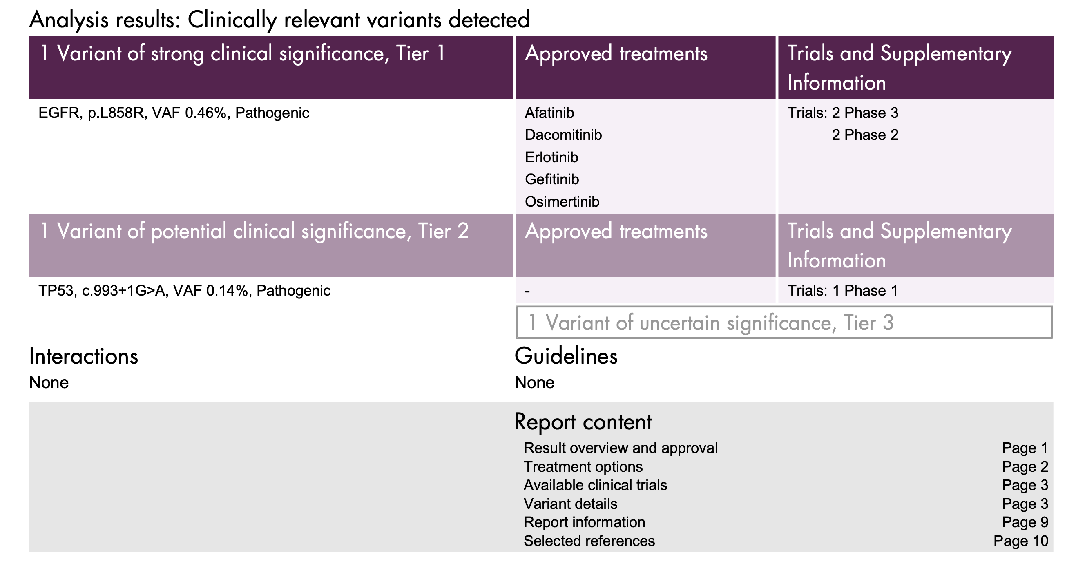
Liquid biopsy biomarker report – variant detected
Notes:
Variant allele frequency (VAF) - Is a surrogate measure of the proportion of DNA molecules in a specimen carrying the variant.
For more information see:
Variant of uncertain significance (VUS) - https://www.genomicseducation.hee.nhs.uk/glossary/variants-of-uncertain-significance/
Transcript:
Continuing down the report, the next section we see is the analysis results section, here clinically relevant variants are listed alongside their variant allele frequencies, VAFs for short. VAF is shown as a percentage and indicates how much of the DNA in the sample carries a specific genetic change. Essentially, it is an estimate of what percentage of the DNA in the sample is mutant tumour DNA out of all the cell-free DNA present. Therefore, the VAF is dependent not only on patient’s tumour burden – the total amount of cancer present in a person’s body – but also on tumour fraction – the proportion of circulating tumour DNA in the plasma, and tumour heterogeneity.
In this patient’s cfDNA sample, the clinically actionable EGFR variant L858R was identified a VAF of 0.46%. This variant is classified as Tier 1, pathogenic. Alongside the variant, the associated NICE approved targeted therapies are listed in the second column, and any potential trials and their trial phase are listed in the third column.
A TP53 variant was also detected, this variant can provide prognostic information. There are no treatments linked to TP53 variants in lung cancer, but a trial is noted that can be explored further by the clinician if required.
The number of variants of uncertain significance are also given in this section and these are further described in more detail later in the report. These are variants that lack sufficient evidence to know what disease or clinical management impact they might have. In this sample one such variant was detected. As their clinical significance is not known, they are not described here or in the overall comment section. Typically, variants of uncertain significance are not reported in genomic testing, however in ctDNA testing these are included as they can provide an indication that tumour derived variants have been detected in the specimen.

Slide 6
Summary
To summarise, the first page of this example report provides an overview of the patient’s liquid biopsy biomarker results. It includes the detected genetic variants, their Variant Allele Frequencies, and potential associated clinical options.
Additionally, depending on the test, it may include the Microsatellite Instability or RB1 results.
This initial page often contains all the key information needed to contribute to the patient's treatment plan. It indicates whether tumour DNA is present and if a targeted therapy is available based on the genetic profile.
Notes:
For more information see:
(1) Circulating tumour DNA for cancer patients - https://www.genomicseducation.hee.nhs.uk/genotes/knowledge-hub/circulating-tumour-dna-for-cancer-patients/
Circulating tumour DNA is a subset of cell free DNA, which is double-stranded DNA released into the bloodstream from cells undergoing cell death or dividing. Circulating tumour DNA is commonly taken as a liquid biopsy to investigate a cancer. At present, the most common liquid biopsy in clinical practice and research is circulating tumour DNA from the peripheral blood.
(2) Variant - https://www.genomicseducation.hee.nhs.uk/genotes/knowledge-hub/variant/
A variant is any difference between the DNA sequence of two individuals’ genomes or a reference genome. Variants can be harmless or disease-causing (pathogenic).
(3) Marsden360 - https://www.royalmarsden.nhs.uk/marsden360
Transcript:
To summarise, the first page of this example report provides an overview of the patient’s liquid biopsy biomarker results. It includes the detected genetic variants, their Variant Allele Frequencies, and potential associated clinical options. Additionally, depending on the test, it may include the Microsatellite Instability result. This initial page often contains all the key information needed to contribute to the patient's treatment plan. It indicates whether tumour DNA is present and if a targeted therapy is available based on the genetic profile.
The remainder of the report includes further detail about the variants, treatments, or clinical trials. I will now work through these next sections of the report. It is noted, that this report does not necessarily take account of NICE prescribing guidelines and does not substitute for clinical expertise. Clinicians should make treatment decisions based on routine prescribing guidelines, but there may be some useful information included in the report.

Slide 7
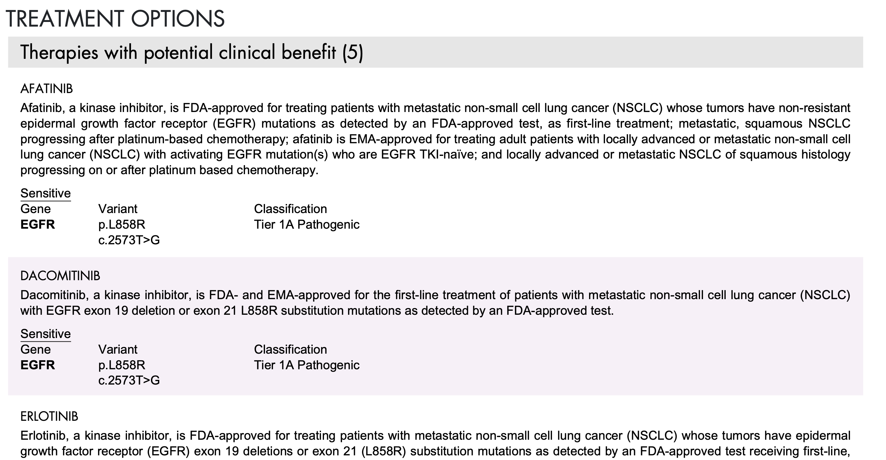
Liquid biopsy biomarker report – variant(s) detected
Notes:
Transcript:
Following the summary of results on the front page of the report, the next report pages first outline the treatment options available related to the provided diagnosis and the variant. Described is the drug response as ether sensitive or resistant and the evidence to support this.

Slide 8
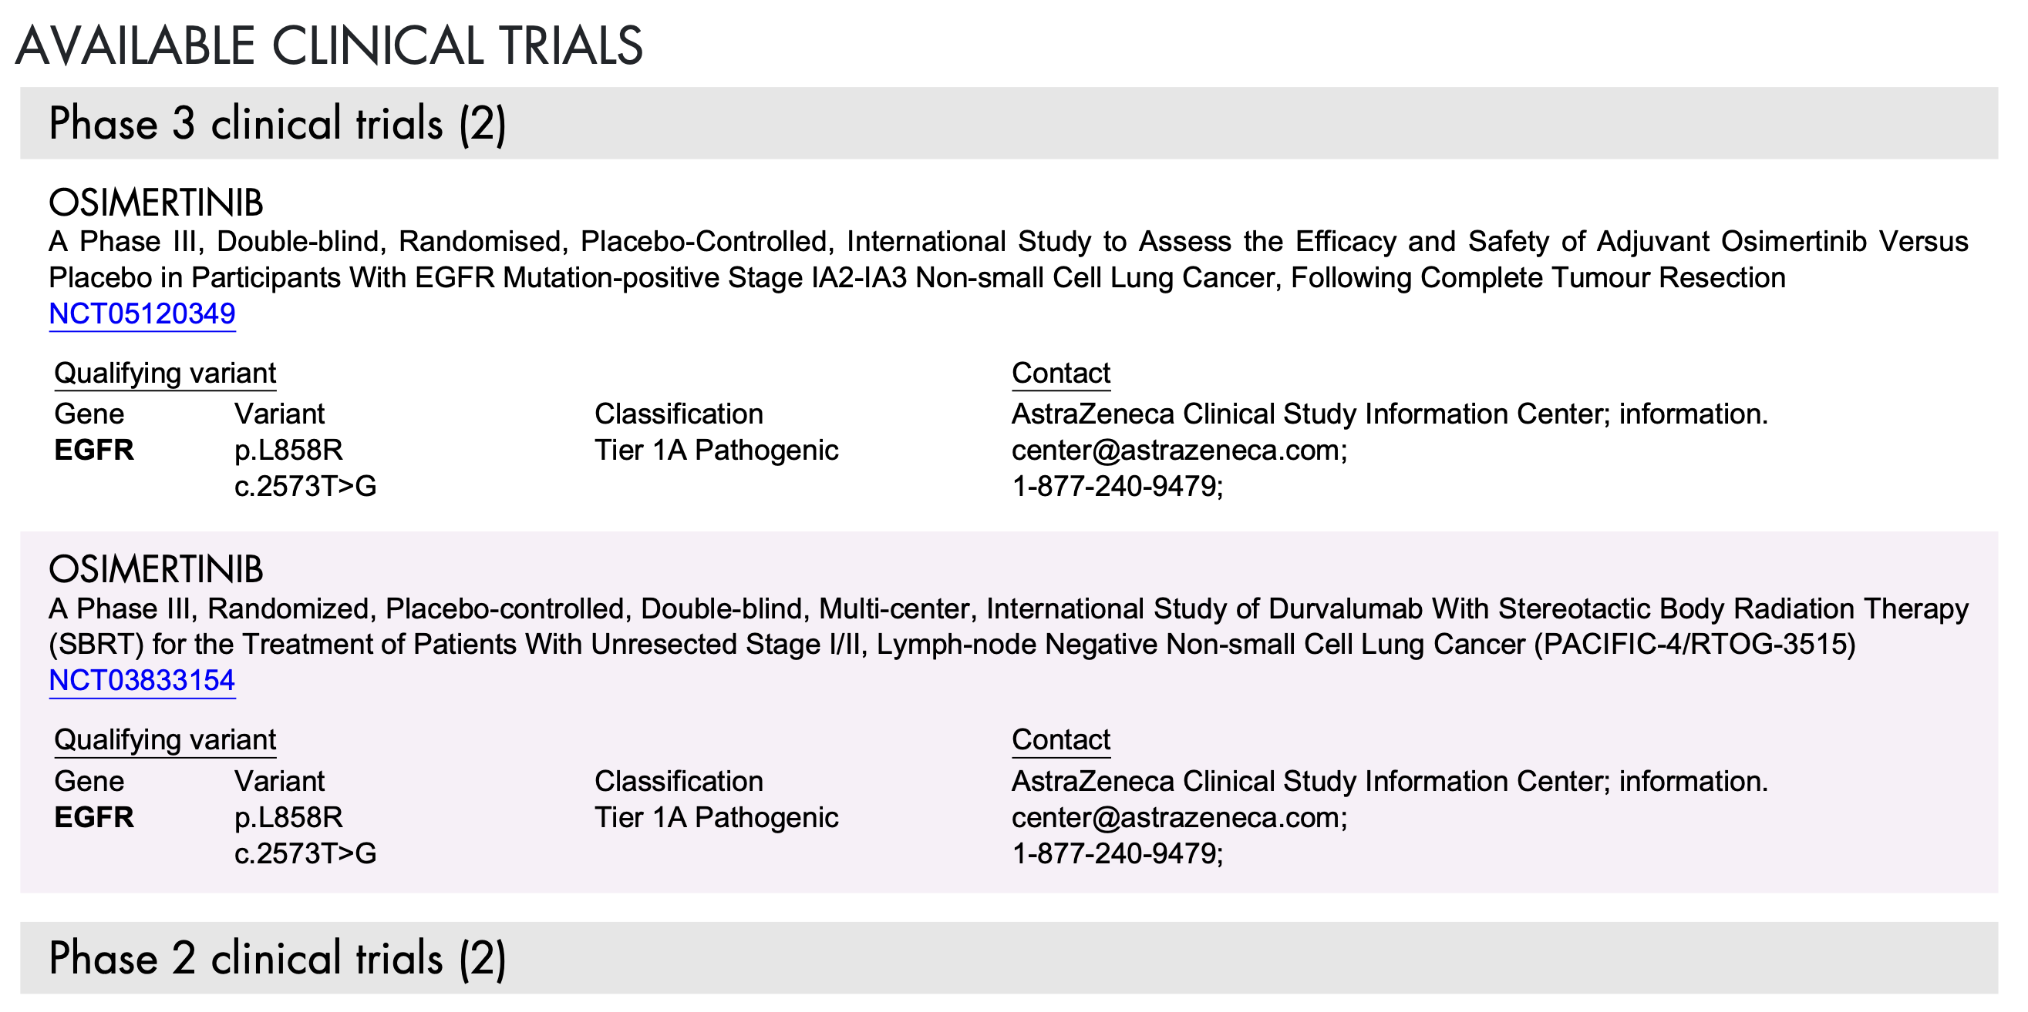
Liquid biopsy biomarker report – variant(s) detected
Notes:
Transcript:
After treatment options, is a section on available clinical trials. This lists currently enrolling studies pertinent to the genomic variants and/or genes of interest. The clinical trials have been pre-filtered to include only UK trials and an online link to the clinical trial record is provided to seek further detail.

Slide 9
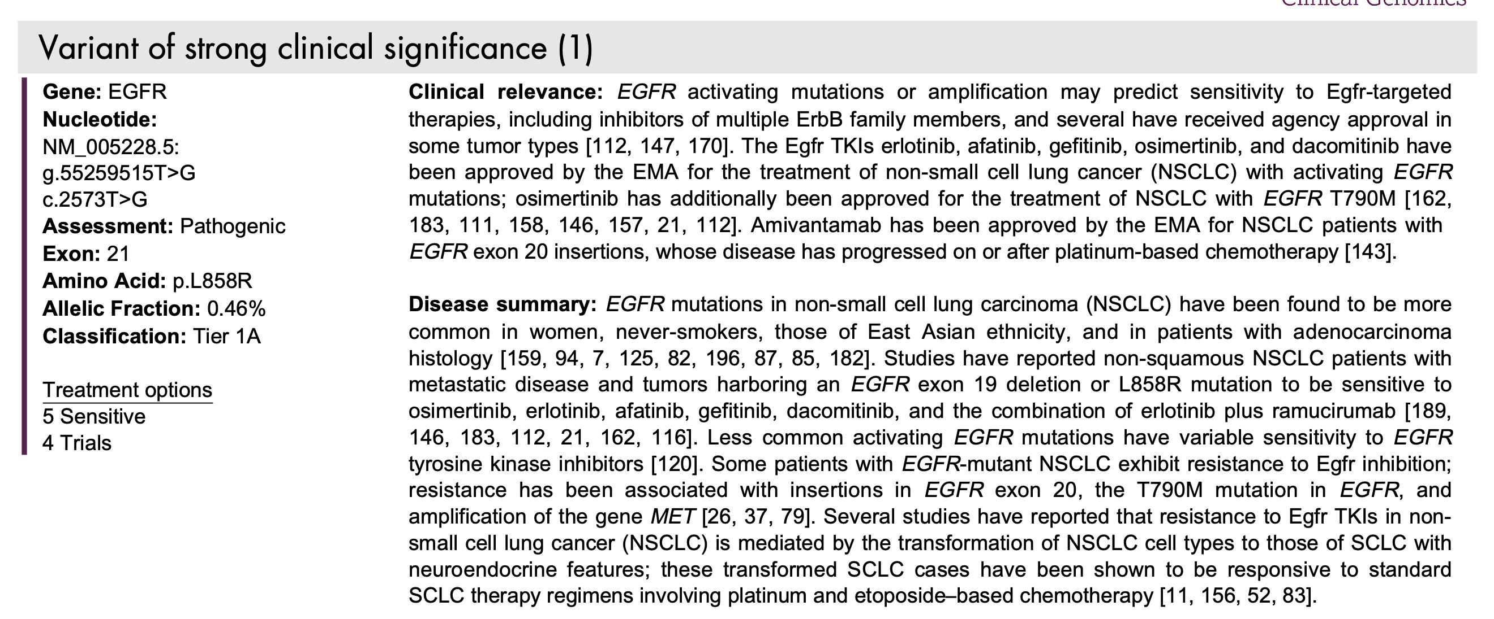
Liquid biopsy biomarker report – variant(s) detected
Notes:
Transcript:
The report then moves on to provide more information on the clinically and biologically relevant variants detected by the test. This includes information on the gene, and its association with the diagnosis and role in disease. It provides information on the clinical significance of the variant, and the clinical evidence about the variants, diagnostic and prognostic indications.
Finally, the variants of uncertain significance detected and their relevant VAF are stated.

Slide 10
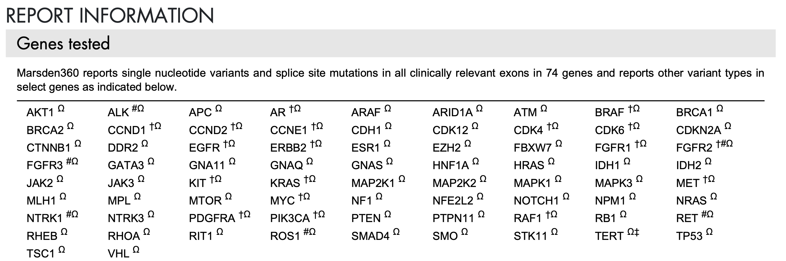
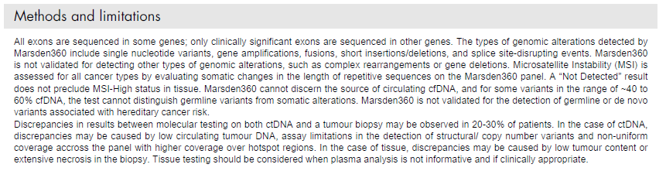
Liquid biopsy biomarker report – variant(s) detected
Notes:
Transcript:
The following report information section gives details on the assay, methods and limitations and selected references. Here a table lists the genes included in the assay and the type of variants detectable by the test in those genes. For example, single nucleotide variants and splice site variants are reported in all clinically relevant exons in the genes that are targeted by the assay, whereas fusions and amplifications are only reported in a subset of genes.
Ω Marsden360 reports insertion and deletion variants (indels) in this gene.
# Marsden360 reports fusion events involving this gene for all known gene partners.
‡ Marsden360 reports alterations in the promoter region of this gene.
† Marsden360 reports amplifications of this gene.
The report then outlines the methodology and the limitations of the assay. Firstly, it’s important to note that a limitation of any ctDNA assay is the risk of a false negative results. A false negative is when the test fails to detect a genetic variant that is actually present in a person's DNA.
Not all cancers release ctDNA into the bloodstream, and many patients, even those with advanced cancer, may have only low levels of ctDNA in their plasma. Therefore, the inability to detect a variant in ctDNA might be due to the absence of the variant in the patient’s cancer or due to low ctDNA levels that prevent detection. If the proportion of ctDNA in the sample is below the assay's limit of detection, it may result in a false negative.
Discrepancies between liquid biopsy results and tumour biopsy results may occur in about 20-30% of cases, influenced by both technical and biological factors. As mentioned, low or absent ctDNA in the specimen could explain discordance between variants detected in tissue samples compared to plasma samples. Conversely, variants may be detected in ctDNA that are not present in the tissue biopsy sample, possibly due to a low percentage of tumour cells in the tissue biopsy, extensive necrosis, or differences in sampling timing as the tumour potentially evolves.
Technical factors that may attribute to differences in results include variations in the design of the tissue and liquid biopsy NGS panel tests, which can vary in the genes that are included in the gene panel, and the regions of those genes included. At the start of this video I mentioned the RB1 gene, and variation in NGS panel design can account for any discordance that may observed between RB1 status in the Marsden360 liquid biopsy results and tissue biopsy results. It’s worth noting, tissue testing may also have been delivered using a non-NGS assay, which provide less comprehensive testing than NGS based tests. As these tests are more limited in the gene regions they cover, for example, some of the more uncommon clinically relevant EGFR variants may not be detectable by these targeted tests.

Slide 11
Liquid biopsy biomarker test - other report types
Potential germline variant has been detected
No variants are detected
Notes:
Transcript:
Having worked through each section of a report with an actionable finding, I will briefly show a couple of examples of some other report types you may receive.

Slide 12
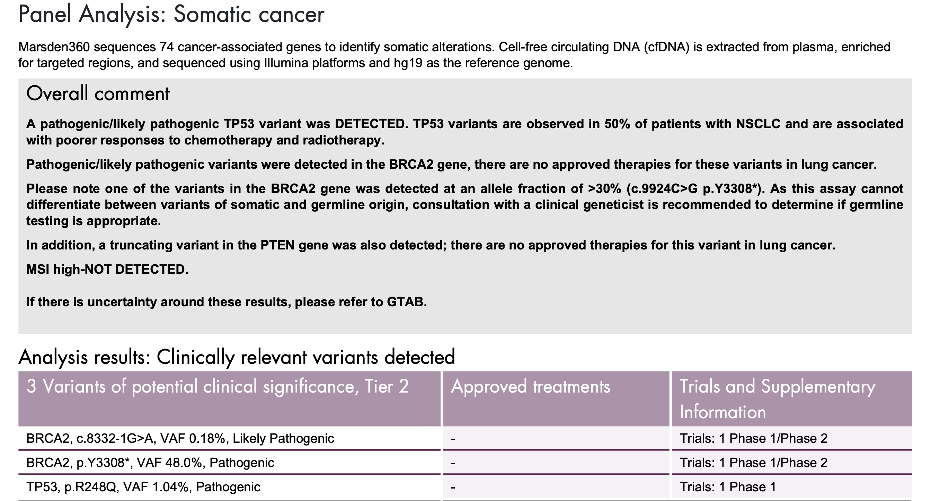
Liquid biopsy biomarker report – germline(?)
Notes:
GTAB - Genomic Tumour Advisory Board
For more information see:
Constitutional (germline) vs somatic (tumour) variants - https://www.genomicseducation.hee.nhs.uk/genotes/knowledge-hub/constitutional-germline-vs-somatic-tumour-variants/
Any variant that occurs in a gamete (egg or sperm) or cells that produce gametes (germ cells) is termed a constitutional, or germline, variant. The resulting embryo and baby will have the variant in every cell of their body that contains a copy of the genome, including the cells that produce their own gametes (see figure 1). The variants could therefore be passed on to their offspring, who in turn could pass the variants on to their offspring and so on.
Cells that are not part of the germline are called somatic cells, and any changes to the DNA that occur within these cells are known as somatic variants. Somatic variants are not present in every cell in the body, and are not passed from parent to child.
Transcript:
Firstly, a report where a potential germline variant has been detected
In the report shown here, the overall comments indicate that tumour-derived or somatic pathogenic variants were found in the BRCA2, TP53, and PTEN genes, with variant allele frequencies around 1% or lower. However, one BRCA2 variant is detected at a much higher VAF of 48%. Since most cell-free DNA comes from normal cells, inherited or germline variants can also be found in the plasma sample and have VAFs around 40%. These potential germline pathogenic variants in cancer predisposition genes are reported. However, the Marsden360 test cannot distinguish between somatic and germline variants. To confirm the origin of this BRCA2 variant for example, germline testing is recommended if deemed appropriate by a clinical geneticist or the multidisciplinary team, as suggested in the report.

Slide 13
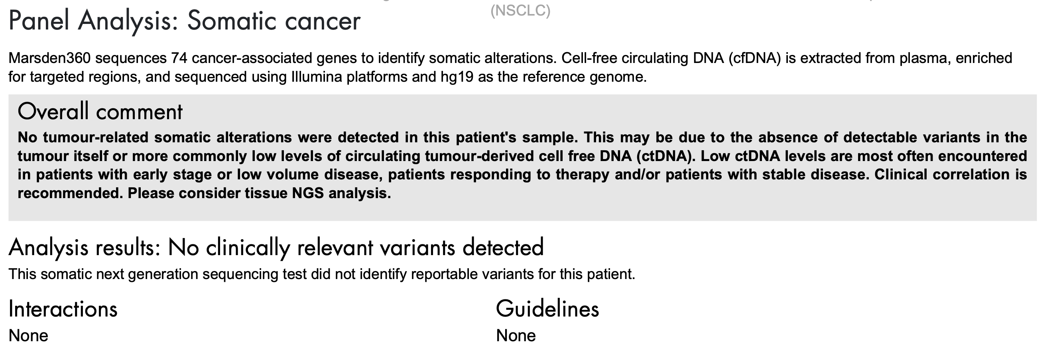
Liquid biopsy biomarker report – no variant
Notes:
Transcript:
In this final example, I show a report where no variants were detected in the patient’s sample. This may be because there is no ctDNA present in the sample, or it’s at such a low level it’s below the sensitivity of the test. It’s important that this is not interpreted as a negative result, only because a variant hasn’t been identified, it doesn’t mean that the patient doesn’t have a variant. This result is considered a non-informative result and tissue testing is advised in this case.

Slide 14
Liquid Biopsy Biomarker Test Report: walkthrough video
Thank you!
The contents of this video is correct at time of release, Aug 2024.
Notes:
For more information on terms used in this video:
See NHS England, Genomics Education Programme – genomics glossary - https://www.genomicseducation.hee.nhs.uk/glossary/
Transcript:
Thank you for watching this video walkthrough of a liquid biomarker biopsy report for a lung cancer patient. As noted, the format of your report may vary, but the key information covered here will still be relevant and can be used to help you understand these similar reports. Lastly, we would like to remind you, for any advice on interpreting a patient’s genomic report, or if there is there is any uncertainty around the significance of any genomic variants reported please consult your MDT team or Genomic Tumour Advisory Board.

