Slide 1
Pharmacogenetics: Pathway and governance considerations
- Implementing CYP2C19 testing
Dharmisha Chauhan – Lead Genomic Medicine Pharmacist

Slide 2
Why focus on CYP2C19?
Notes:
Mavacamten

Slide 3
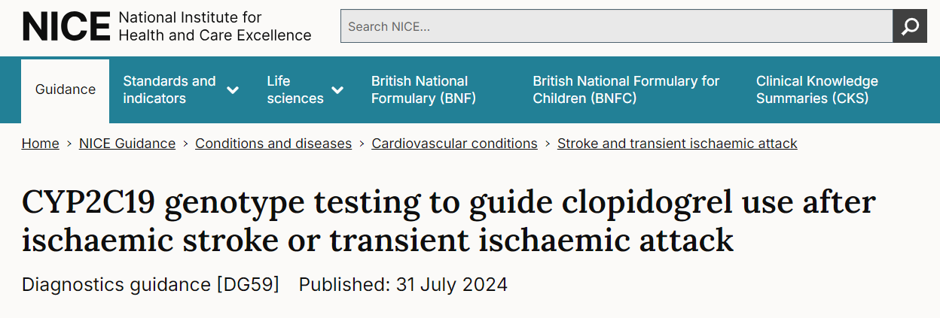
Why focus on CYP2C19?

Slide 4
Learning objectives
To understand:
The role of CYP2C19 testing for clopidogrel
The methods of how CYP2C19 testing can be implemented into systems.
The limitations of testing and key questions which need to be asked for local implementation.
Key governance considerations
Awareness of the resources required for CYP2C19 testing
Notes:
20 mins and 10 mins for questions

Slide 5
CYP2C19
CYP2C19 gene encodes for the enzyme CYP2C19
Involved in the metabolism of many drugs including antidepressants, proton pump inhibitors, clopidogrel and voriconazole
CYP2C19 gene located on chromosome 10, at the location 10q23.33
The first variant identified in 1994, related to poor metaboliser status; *2 allele
Over 35 CYP2C19 variants identified.

Slide 6
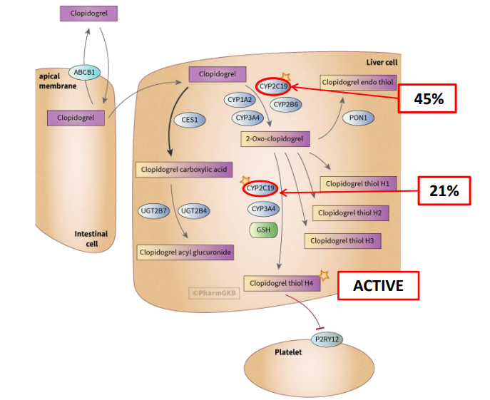
Clopidogrel
Pro-drug, requiring hepatic bioactivation.
Two-step process
Clopidogrel is converted to 2-oxo-clopidogrel via CYP2C19, CYP1A2, CYP3A4 and CYP2B6
2-oxo-clopidogrel is converted to the ACTIVE clopidogrel thiol H4 metabolite via CYP3A4 and CYP2C19
Slide acknowledgement: CPIC

Slide 7
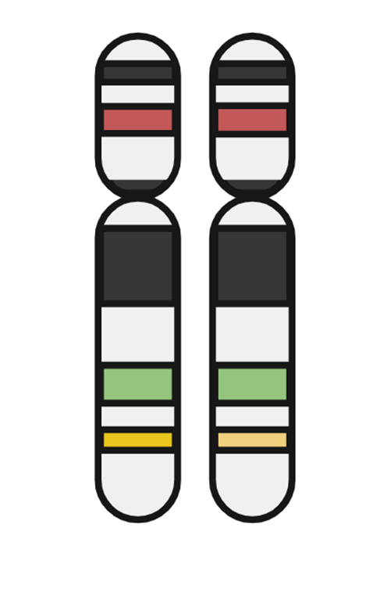
CYP2C19 variants
Everyone inherits 2 alleles, 1 from each parent.
Allele function can be defined as gain of function (increased enzyme activity) to loss of function (reduced enzyme activity)
Each allele is given a star (*) number to simplify gene nomenclature
The combination of the alleles are used to determine the overall enzyme activity.
If the combination of alleles lead to a poor metaboliser status, then clopidogrel will not be effective.
Highly polymorphic – variation in ancestry
HAPLOTYPE
*2
*2
*3
DIPLOTYPE
Poor metaboliser

Slide 8
CYP2C19 phenotype by ancestry
Ultrarapid/Rapid
Normal
Intermediate/likely intermediate
Poor/Likely Poor
Lee CR, et al. Clin Pharmacol Ther. 2022;112(5):959-967.
Slide acknowledgement: NICE
Notes:
Emma to discuss more

Slide 9
The evidence
Study | Study type | Country | Eligibility | Tx/comparator | N | Primary outcome | CYP2C19 LOF / 1º difference?
PRINCE (2019) | Post-Hoc Analysis of RCT | China | Minor stroke or High-risk TIA | Ticagrelor +Aspirin vs Clopidogrel +Aspirin | 675 | HPR at 90 days | Yes
Lv et al (2021) | Cohort | China | IS | Clopidogrel or aspirin | 485 | Composite vascular outcomes | Yes
CHANCE-2 (2021) | RCT | China | Minor Stroke or High-Risk TIA or LOF carriers | Ticagrelor +Aspirin vs Clopidogrel +Aspirin | 6412 | Recurrent stroke | Unable to assess. Risk of primary event lower in Ticagrelor arm.
Pilling et al (2021) | Cohort | UK | Patients in UK-Biobank Prescribed Clopidogrel | Clopidogrel | 7477 | IS | Yes
Patel et al (2022) | Cohort | USA | Carotid artery stenosis | Clopidogrel and aspirin | 1110 | First time IS | Yes
IS: ischemic stroke; LOF: loss of function
MCDermott et al (2022) https://doi.org/10.1080/17512433.2022.2108401.
Notes:
1.McDermott JH, Leach M, Sen D, Smith CJ, Newman WG, Bath PM. The role of CYP2C19 genotyping to guide antiplatelet therapy following ischemic stroke or transient ischemic attack. Expert Review of Clinical Pharmacology. 2022;15(7): 811–825. https://doi.org/10.1080/17512433.2022.2108401.

Slide 10
Summary of Product Characteristics

Slide 11
NICE diagnostic guidance
Recommendation = positive
The NICE guidance does NOT mandate the NHS to implement this intervention.
However, genetic testing in patients who have had a stroke can be an effective tool in assessing whether clopidogrel is an appropriate treatment to prevent further strokes.

Slide 12
How would we test? - As set out within the NICE diagnostic guidance
1st choice
2nd choice
3rd choice
Laboratory testing
Usually requires a blood test
Genedrive test
Uses a cheek swab
Point of care, 1 hour to run
Genomadix test
Uses a cheek swab
Potentially a wide range of alleles can be detected
Sample must be transported to laboratory, longer turnaround time
Displays diplotype and metaboliser status
Store at room temperature
Point of care, 1 hour to run
Store in a freezer
Displays diplotype
£44–£139 per test
£100 per test plus VAT
£125 per test plus VAT
Assume gold standard accuracy
Sensitivity 100% (95%CI 96% to 100%), Specificity 100% (98% to 100%)
Sensitivity 100% (95%CI 94% to 100%), Specificity 100% (99% to 100%)
Slide acknowledgement: NICE

Slide 13
Which alleles will be tested?
 | Tier 1 |  |  | Tier 2
ACMG | *2 | *3 | *17 | *4 | *5 | *6 | *7 | *8 | *9 | *10 | *35
NHS GLH | ? | ? | ? | ? | ? | ? | ? | ? | ? | ? | ?
GeneDrive | x | x | x | x |  |  |  | x |  |  | x
Genomadix | x | x | x
23andMe | x | x | x
Other commercial suppliers | ? | ? | ? | ? | ? | ? | ? | ? | ? | ? | ?
x | x | x
Two other rare variants of interest
*36 – full gene deletion
*37 – partial gene deletion
NHS commissioned testing: Will be determined/agreed upon by scientists, pharmacogenomic experts at a laboratory and clinical level. Also linked to technology available.
**GLH; Genomic Laboratory Hub: ACMG; American College of Medical Genetics and Genomics

Slide 14
Laboratory testing – a caveat…
Use laboratory-based testing
1st choice
A phased rollout with testing initially offered to people with a higher risk of stroke recurrence who could benefit most from it.
Variants to be still to be decided.
Pilot sites yet to be decided.
Point of care testing verses laboratory testing approach

Slide 15
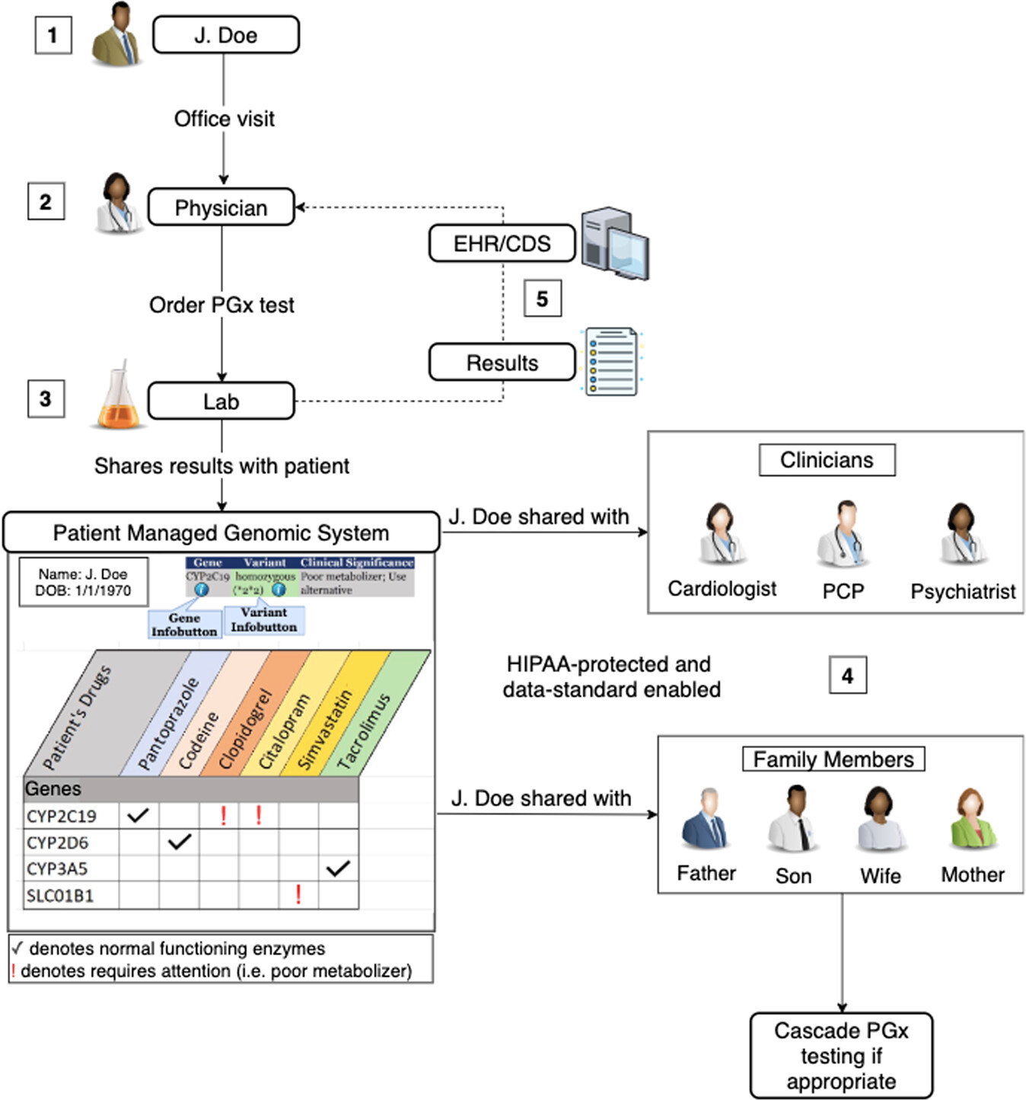
Implementation and governance
Gathering institutional support
Impact assessment
CYP2C19 delivery methods
Integrating CYP2C19 into electronic patient records
Resources
Patient information
Education and Training within pharmacogenomics
Notes:
Implementation Guides - Ignite II (gmkb.org)

Slide 16
Step 1: Gather institutional support
Stroke and cardiovascular teams e.g., doctors and nurses
Lead pharmacists for the clinical area the test is being considered in e.g., stroke clinicians
Chief Pharmacist
Governance pharmacists and clinical governance leads
Laboratory lead manager/team members
Pathology department
Formulary teams/DTC team members
Pharmacologists
Patients
Data suggests that pharmacogenetic services are primarily pharmacy led
BUT
For successful implementation you NEED buy-in from consultants/doctors
BECAUSE
They carry out majority of the prescribing
Implementation support from GMSA pharmacists (subject matter experts) and ICBs (guidance on regional implementation)

Slide 17
What questions do you need to ask?
Who to test?
Those who have just had a stroke or TIA
Not for retrospective testing
Children can be considered where clinically appropriate
When and where to test?
Do not delay treatment, if poor metaboliser – change treatment
Acute stroke ward vs after discharge?
Shared decision making?
Consent vs capacity
Clinical pathway stroke unit vs GP/primary care
What are the implications for other drugs?
Consideration for the uses of other clopidogrel indications?
acute STEMI (ST-segment elevation myocardial infarction)
acute NSTEMI (non-STEMI)
ongoing secondary prevention after MI for some people
Proton pump inhibitors
Selective serotonin reuptake inhibitors (SSRIs)
Tricyclic antidepressants
Voriconazole
Slide acknowledgement: NICE
Notes:
Capacity
Where does your recommendations fit in which other NICE guidelines/product licensing?
Other drugs
Proton pump inhibitors
Selective serotonin reuptake inhibitors (SSRIs)
Tricyclic antidepressants
Voriconazole

Slide 18
Step 2: Impact assessment
Clinical pathway and workflow
Disruptive?
Formularies
Roles & responsibilities
UK based guidelines
Capacity to test
POCT vs lab testing
Quality control
Laboratory reports and digital interfaces
Transport of samples
CYP2C19 testing
Harms verses benefits
Unintended consequence
Number needed to identify for cost effectiveness
Cost of implementation > cost-benefit
Patient demographics
Licensing and cost of alternative treatments
Patient information
Non-genetic factors!!
Consent vs capacity
Data sharing
Education and training
New roles?

Slide 19
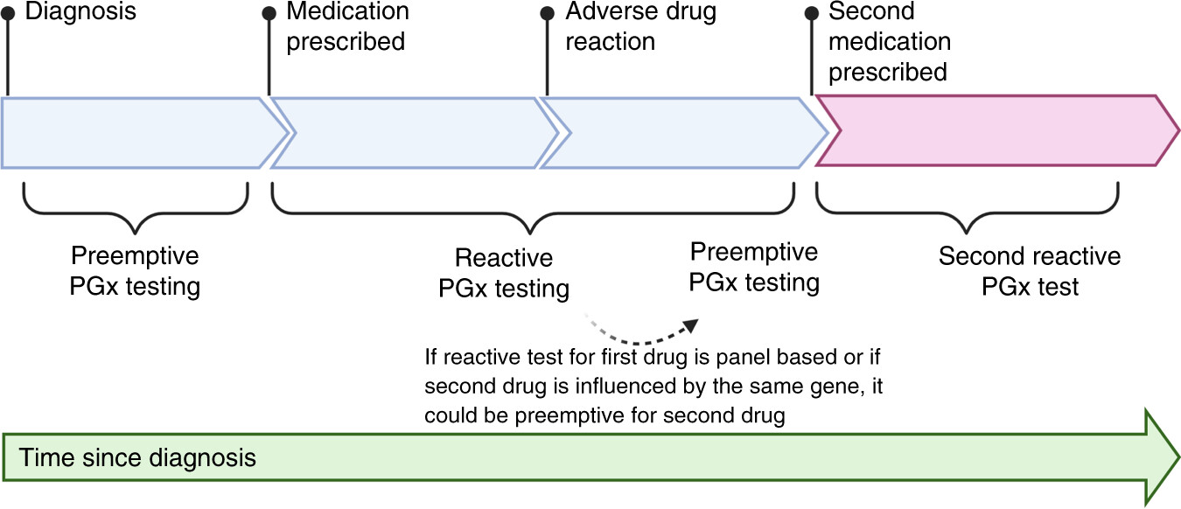
Step 3: CYP2C19 testing delivery methods
Hours
Turnaround time is important to consider
https://doi.org/10.1038/s41390-021-01499-2.
Notes:
1.Girdwood SCT, Rossow KM, Driest SLV, Ramsey LB. Perspectives from the Society for Pediatric Research: pharmacogenetics for pediatricians. Pediatric Research. 2022;91(3): 529–538. https://doi.org/10.1038/s41390-021-01499-2.

Slide 20
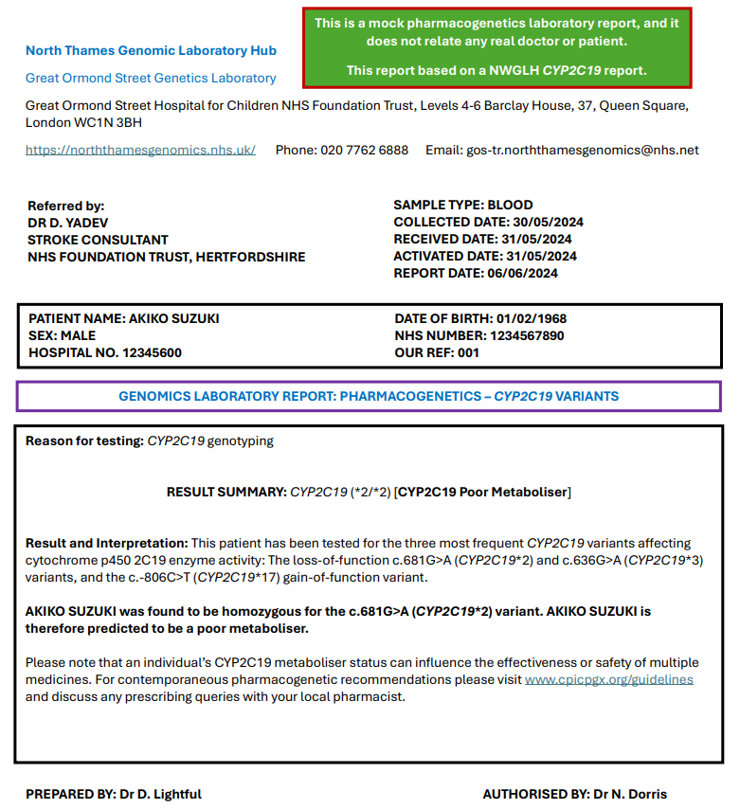
Step 4: Integrating CYP2C19 data into systems
Secure data storage
SNOMED-CT
codes
Notes:
SNOMED CODES
Different clinicians may use different resources and come up with a different answer but correct based on the chosen guideline – need for consensus.
PIL – Sas/ East Asian
Patient presents to stroke unit
HCP requests pharmacogenetic test
Sample sent to GLH vs POCT
Result back to HCP (5 to 10 days) vs 1 hour
Clinical decision tools – but if laboratory, who does the interpretation?
Results to be shared with
Cardiologist
GP
Psychiatrist
Patient shares their result to other family members

Slide 21
Step 5: Resources to interpret CYP2C19
What’s out there?

Slide 22
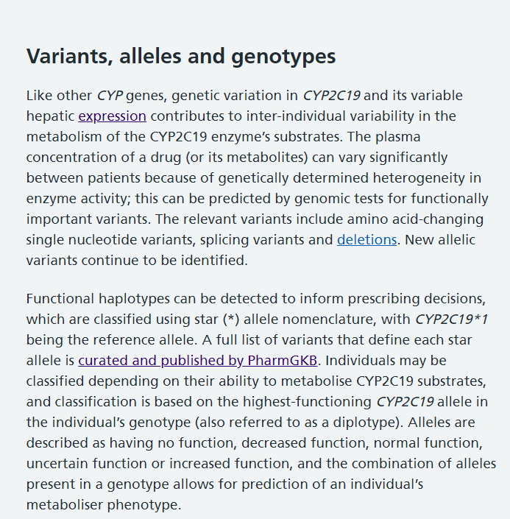
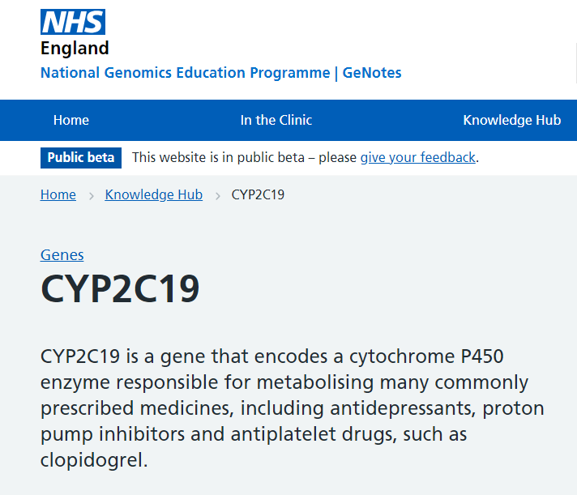
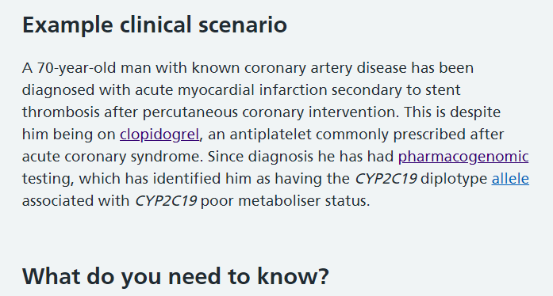
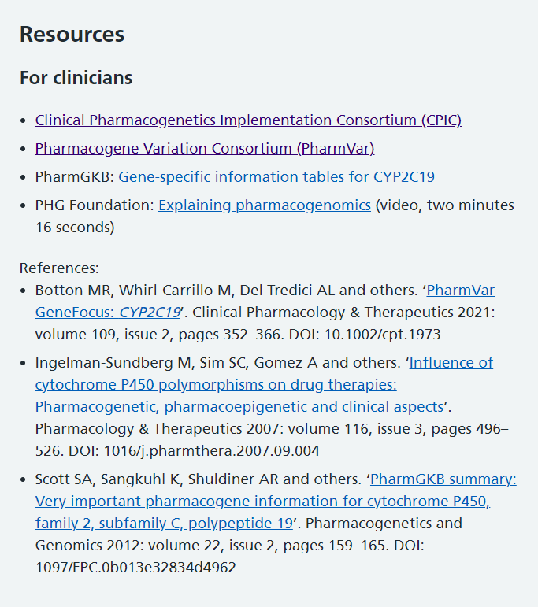
Resources – for an overview of a gene
GeNotes
Just in time resources which also signposts you to international guidelines and other useful papers and resources.
A quick overview of the information with an example clinical scenario.
PIL available - Cincinnati Children’s Hospital

Slide 23
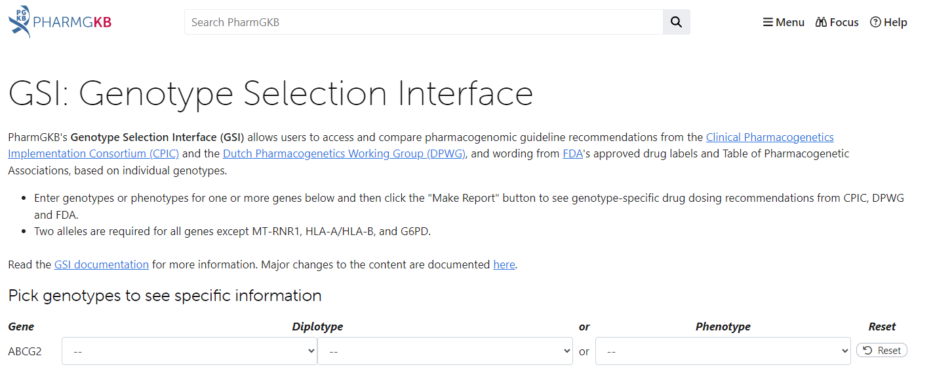
Resources – to aid interpretation
Published guidelines
Clinical Pharmacogenetics Implementation Consortium (CPIC) Guidelines – CPIC (cpicpgx.org)
Dutch Pharmacogenetics Working Group (DPWG)
Production information
Summary of Product Characteristics
BNF
Online tools/apps – to aid interpretation
PharmGKB
DNA-Driven Rx (pharmgkb.org) or can use
GSI: Genotype Selection Interface (pharmgkb.org)

Slide 24
How are the results interpreted?
Phenotype | Diplotype | Action on the drug
Ultrarapid metabolisers | Two increased function alleles (*17/*17) | Can use clopidogrel at standard doses with desired effectiveness and no increased bleeding risk
Normal metaboliser | 2x normal functional alleles (*1/*1)
Intermediate metabolisers | One normal function allele and one no function allele (*1/*2) OR One increased function allele and one no function allele (*17/*2) | Reduced clopidogrel effectiveness: consider an alternative antiplatelet drug
Poor metabolisers | Two loss of functional alleles (*3/*2) | Significantly reduced clopidogrel effectiveness: avoid clopidogrel and consider an alternative antiplatelet drug
GENEOTYPE | PHENOTYPE
CYP2C19*1 | Normal function
CYP2C19*2 | Loss of function
CYP2C19*3 | Loss of function
CYP2C19*17 | Gain of function
*ethnicity
Slide acknowledgement: NICE

Slide 25
Developing guidelines…
CYP2C19 ultrarapid and rapid metabolisers
CYP2C19 normal metabolisers
CYP2C19 intermediate metabolisers
CYP2C19 poor metabolisers
Increased clopidogrel bioactivation. No association with higher bleeding risk.
Normal clopidogrel bioactivation
Reduced clopidogrel bioactivation. Increased risk for adverse cardiac and cerebrovascular events.
Initiate standard dose*
Avoid clopidogrel
An alternative drug needs to be considered
Notes:
Based on CPIC guidelines
No UK guidelines as yet

Slide 26
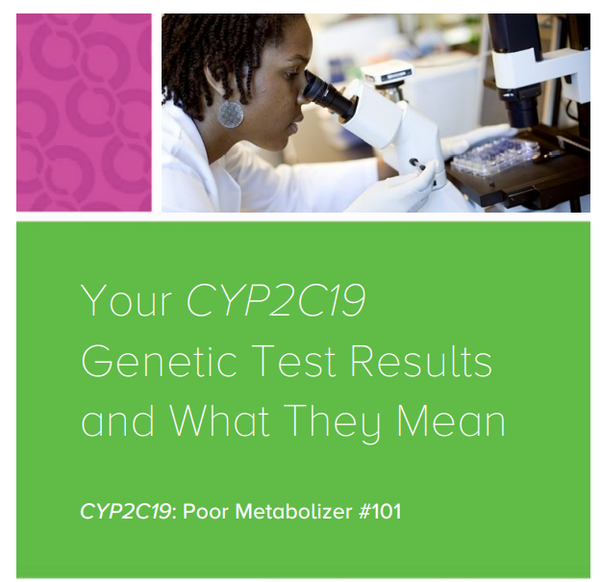
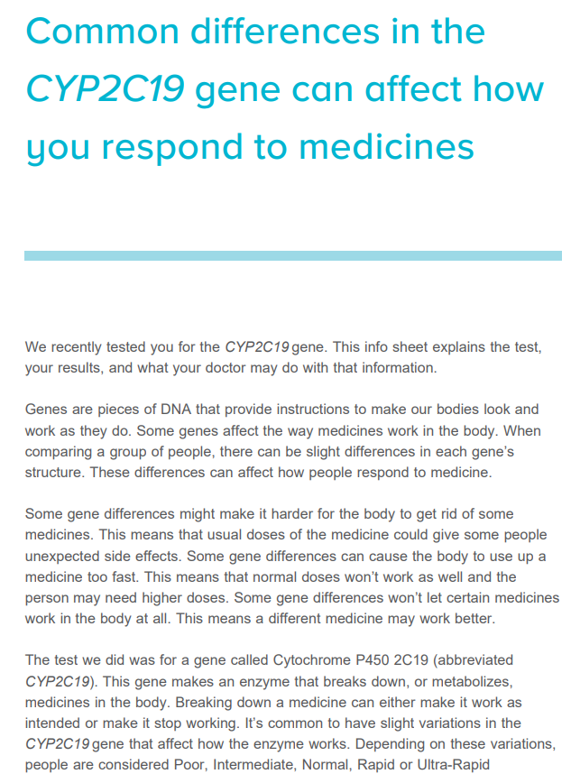
6. Patient education
Consent
Verbal or written?
Lay information?
Language barriers
Creative/visual methods required – videos
Ideas, concerns and expectations
Shared decision making with the patient
Time to counsel patient:
Pre and post pharmacogenetic counselling

Slide 27
Pharmacogenetic counselling
P | Purpose and benefit of pharmacogenomic testing
G | Genetic concepts
X | Example of a pharmacogenomic concept
D | Drawbacks of pharmacogenomic testing
R | Risks and concerns
U | Understand the patient’s perspective
G | Game plan and process
S | Sharing results
Pre-test counselling?
PGXDRUGS
Is it necessary to go through all of this information?
Who should do this?
Time?
Post-testing counselling?
OPTIMIZED
Education and knowledge?
Patient genomic literacy?
Language?
Time?
O | Overview of the pharmacogenomic results
P | Pharmacogenomic interactions
T | Take account of gene-drug-drug interactions
I | Initial drug change considerations
M | Manage genes with future, familial and disease-risk implications
I | Interpretation and application updates over time
Z | Zero in on patient comprehension
ED | Education about sharing results and supplemental information
Mnemonics for Elements of Pretest Pharmacogenomics Counselling, taken from Ho TT et al. A clinician’s guide for counselling patients on results of a multigene pharmacogenomic panel. American Journal of Health-System Pharmacy. 2022;79(19): 1634–1644. https://doi.org/10.1093/ajhp/zxac189

Slide 28
Summary
You may have noticed; I have asked more questions than I have provided answers!!
Implementing a pharmacogenetic testing e.g., CYP2C19 requires the pathway to be reviewed, which can differ between organisations/regions:
How will the pathway be affected?
What are the consequences of testing vs not testing?
How does this affect the population that I serve?
Most questions (esp. governance) will need a national answer e.g., UK based guidelines, digital and patient information/resources
As we embark on a pharmacogenetic pathway within the NHS…
start with improving our collective genomic knowledge within healthcare systems.

Slide 29
Questions and discussions

Slide 30
Lunch
Workshops – after lunch
Lecture room - Clopidogrel
Downstairs - Lansoprazole

