Slide 1
CYP2C19 Workshop
Focus on clopidogrel

Slide 2

Disclaimer
The pharmacogenetic reports provided are mock reports, for education and training purposes only.
  A real-life pharmacogenetic report from the Genomic Laboratory Hub may look different.
There are no UK based guidelines for clopidogrel to guide UK prescribing practices…as yet…
  Prescribing practices will be aligned to national e.g., NICE recommendations/SmPC with consideration to local practices, guidelines and formularies.
Hopefully, this workshop will not only help raise awareness of the pharmacogenetic resources available but ignite conversations/thoughts on how these resources can differ to our UK/local practices and what we already know about medicines.
Pharmacogenomics will not replace our clinical judgement; it is an additional tool within our medicines optimisation toolbox, we still need to consider factors such as, renal and liver function, drug interactions, co-morbidities etc…
Notes:
Image from: Group People Cartoon Images - Free Download on Freepik

Slide 3
Learning objectives
Understand the difference between genotype and phenotype
Understand the terminology of phenotype definitions
Recognise the different CYP2C19 variants
Be able to assign the correct phenotype to a genotype
Make a therapeutic recommendation using available pharmacogenetic resources.

Slide 4
Navigating through the definitions!

Slide 5
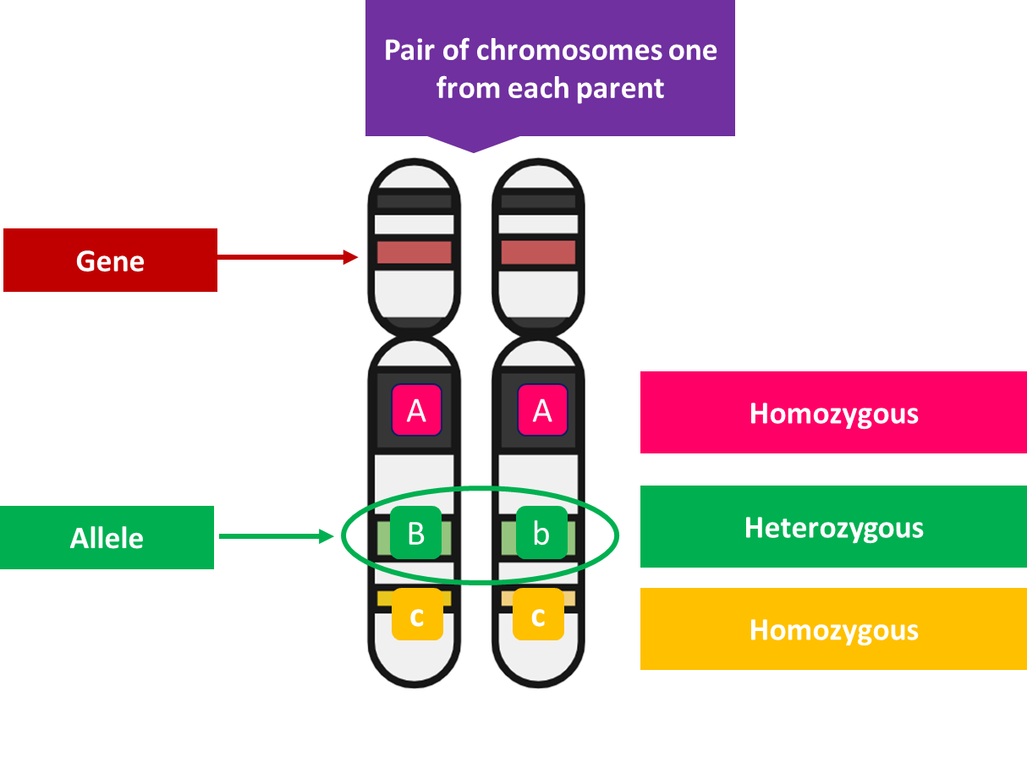
Gene, variant and allele
GENE:
  A unit of inheritance and is passed from each parent to a child.
  This gene contains information on how to build a protein.
VARIANT:
  A site where the part of the gene you are looking at is different to the reference genome
ALLELE:
  An allele is a specific version of a gene.
  Each person inherits two alleles of a gene, one from each parent.
Notes:
GENE: In humans we have approximately 20,000 protein coding genes. Which represents 1.5% of our entire human genome.

Slide 6
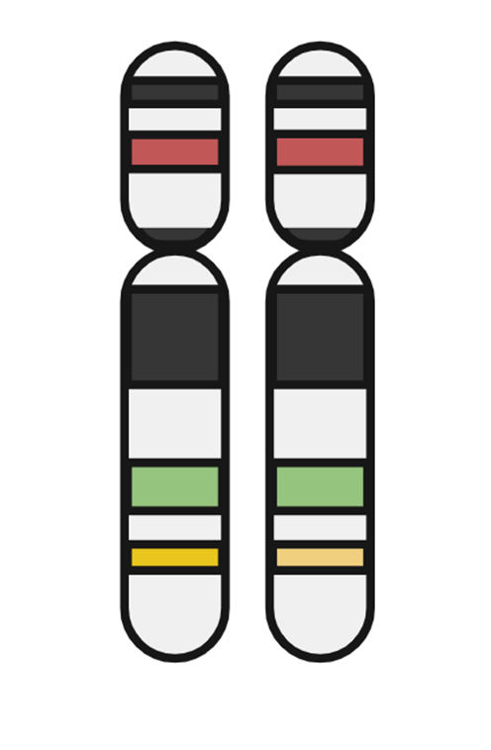
Haplotype and diplotype
A HAPLOTYPE refers to the combination or patterns in which alleles can be found in individuals.
A haplotype can be a single gene allele or a group of alleles which can be found together.
Within pharmacogenetics we are interested in the DIPLOTYPE which is a combination of TWO haplotypes because this will determine the overall phenotype within pharmacogenetics e.g., co-dominant trait.
HAPLOTYPE
*1
*1
*3
DIPLOTYPE

Slide 7
Genotype
GENOTYPE: the set of alleles which have been inherited and will determine a given characteristic and will determine what will be expressed.
In pharmacogenetics a STAR (*) ALLELE NOMENCLATURE SYSTEM is used
GENETIC VARIANT
Human Genome Variation Society nomenclature | Star (*) Allele Nomenclature
c.991A>G (reference) | CYP2C19*1
c.332-23A>G c.681G>A | CYP2C19*2
c.636G>A | CYP2C19*3
c.-806C>T | CYP2C19*17

Slide 8
Phenotype
With pharmacogenetics the genotype will determine how much enzyme will be expressed and the expression is known as PHENOTYPE = the observable trait.
GENETIC VARIANT |  | EFFECT
Human Genome Variation Society nomenclature | Star (*) Nomenclature | Phenotype
c.991A>G (reference) | CYP2C19*1 | Normal function
c.332-23A>G c.681G>A | CYP2C19*2 | Loss of function
c.636G>A | CYP2C19*3 | Loss of function
c.-806C>T | CYP2C19*17 | Gain of function

Slide 9
Genotype → Phenotype
DIPLOTYPE | FUNCTIONALITY of the ALLELE | PHENOTYPE | Effect on a PRODRUG
*17 / *17 | Two gain of function alleles | Ultrarapid metabolizers | Increased active metabolite; increased efficacy and toxicity.
*1/*17 | one normal + gain of function | Rapid metabolizer | Increased active metabolite; increased efficacy and toxicity.
*1 / *1 | Two normal functional alleles | Normal metabolizer | Normal active and metabolite concentrations with minimal toxicity.
*1/*2 *1/*3 *2/*17 *3/*17 | One normal function allele + one loss of function allele OR One gain of function allele + one loss of function allele | Intermediate metabolizer | Potential reduction in active metabolite function; possible reduced efficacy.
*2/*2 *3/*3 *2/*3 | Two loss of function alleles | Poor metabolizer | Significantly reduced active metabolite function; reduced drug efficacy.

Slide 10
CYP2C19 phenotype by ancestry
Ultrarapid/Rapid
Normal
Intermediate/likely intermediate
Poor/Likely Poor
Lee CR, et al. Clin Pharmacol Ther. 2022;112(5):959-967.

Slide 11
Resources
What’s out there?

Slide 12
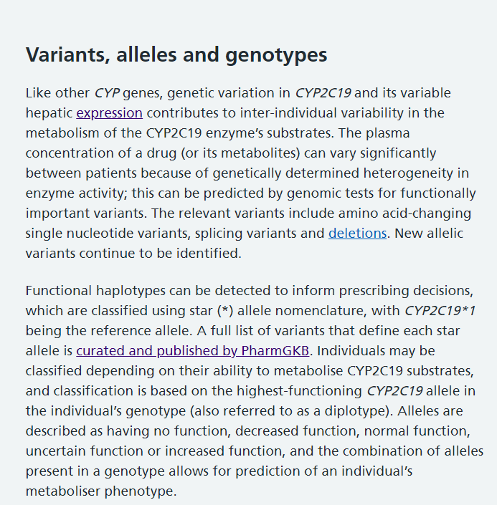
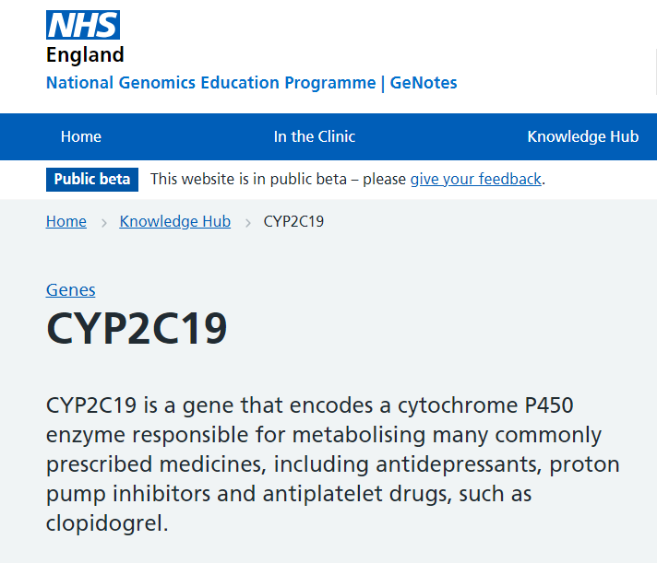
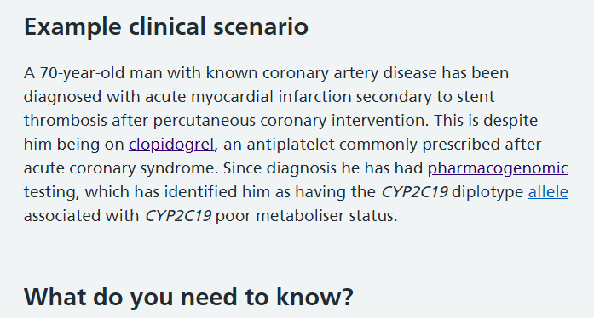
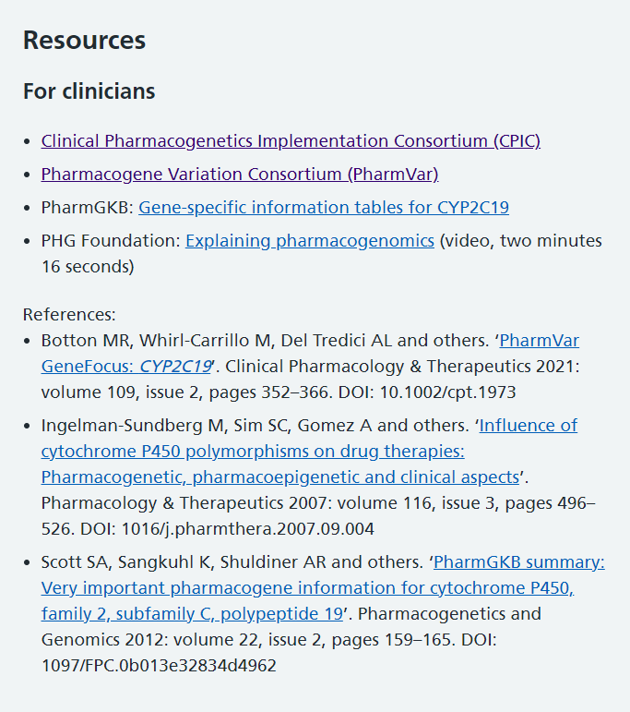
Resources – for an overview of a gene
GeNotes
Just in time resources which also signposts you to CPIC and other useful papers and resources.
A quick overview of the information with an example clinical scenario.
PIL available - Cincinnati Children’s Hospital

Slide 13

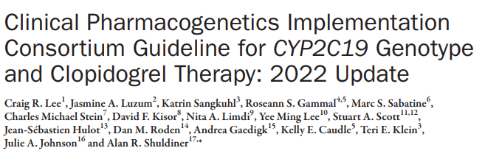
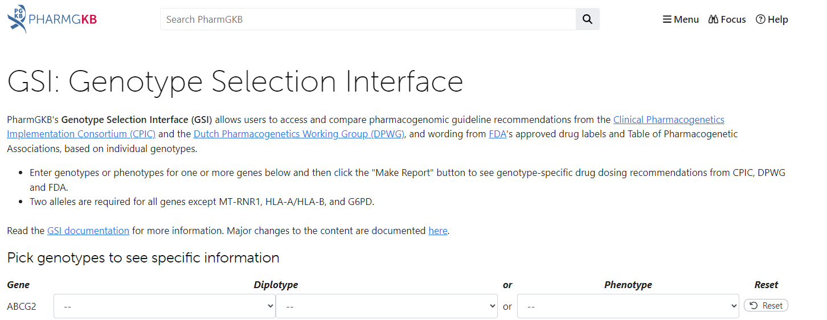

Resources – to aid interpretation
Published guidelines
  Clinical Pharmacogenetics Implementation Consortium (CPIC) Guidelines – CPIC (cpicpgx.org)
  Dutch Pharmacogenetics Working Group (DPWG)
Production information
  Summary of Product Characteristics
  BNF
Online tools/apps – to aid interpretation
  PharmGKB
    DNA-Driven Rx (pharmgkb.org) or can use
    GSI: Genotype Selection Interface (pharmgkb.org)

Slide 14

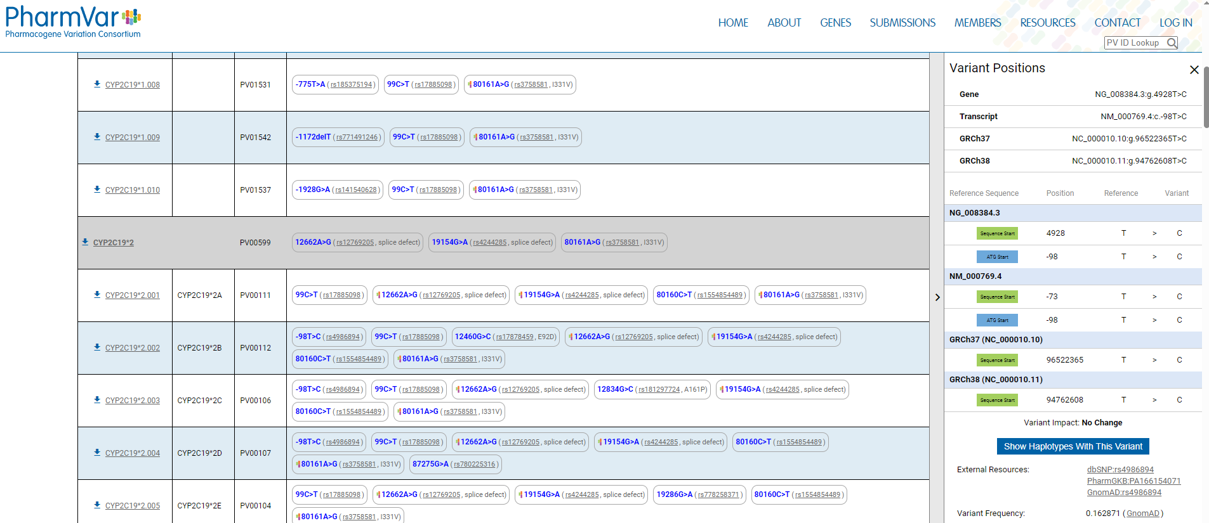
Resources – for detailed genotype information
For those more familiar with pharmacogenetics or embarking on research projects and developing national guidelines – PharmVar is another resource for detailed genotype data.
Not needed for interpretation for the case studies but to raise awareness this site exists, and research papers may refer to it.

Slide 15

Case study 1
Clopidogrel

Slide 16
Patient Akiko Suzuki
Patient Akiko Suzuki is being treated for a minor ischaemic stroke and after the acute management phase Dr Yadev would like to treat Akiko with dual antiplatelet therapy with clopidogrel and aspirin.
Dr Yadev requested a CYP2C19 pharmacogenetic test to ensure that clopidogrel is the right treatment for his patient.
The results are now available, and Dr Yadev has asked you to help interpret the report.

Slide 17
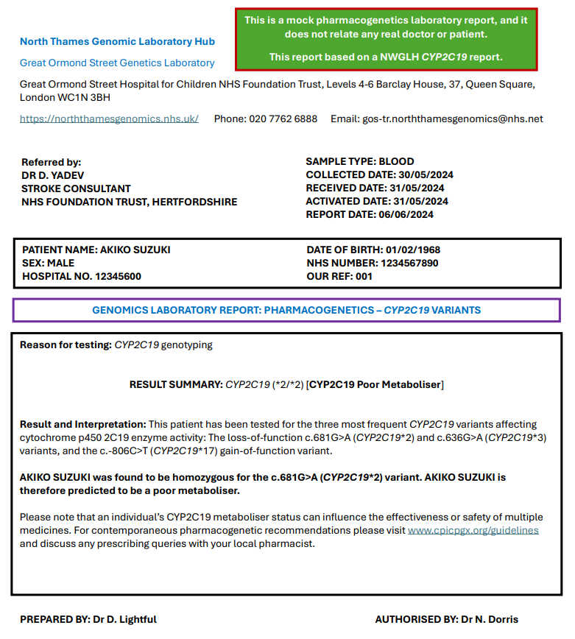
Report for Akiko Suzuki

Slide 18







Pharmacogenetic resources
Webpage
Mobile App
Can use this site to also explore the paediatric dashboard

Slide 19
Question 1
When treating Akiko how would you interpret and action his report?
Please select ONE answer.
The patient can metabolise clopidogrel NORMALLY and the STANDARD DOSE can be prescribed.
The patient’s metabolism of clopidogrel is REDUCED and a DOSE INCREASE is required.
The patient’s metabolism of clopidogrel is REDUCED and an ALTERNATIVE drug will need to be considered.
The patient’s metabolism of clopidogrel is SIGNIFICANTLY REDUCED, and a DOSE INCREASE is required.
The patient’s metabolism of clopidogrel is SIGNIFICANTLY REDUCED and an ALTERNATIVE drug will need to be considered.
I don’t know.

Slide 20
Question 2
When answering question 1, which resource(s) did you use?
Local guidelines
Regional guidelines
National guidelines
Product information e.g. SmPCs
Clinical Pharmacogenetics Implementation Consortium (CPIC) guidelines
Dutch Pharmacogenetics Working Group (DPWG) guidelines
PharmGKB
GeNotes
None e.g., used own knowledge
Other

Slide 21
Question 3
How would you rate your confidence in interpreting Akiko’s results?
Very Poor
Poor
Fair
Good
Excellent

Slide 22
Case study 2
Clopidogrel – optional if time available

Slide 23
Patient Devina Chopra
Devina Chopra is being reviewed in Dr Yadev’s follow up clinic. You are working within his clinic as an independent prescriber. Devina has been on clopidogrel and aspirin for 21 days and the plan will be to continue clopidogrel 75 mg monotherapy once a day.
Devina’s pharmacogenetic result is now available and Dr Yardev has asked you to review the patient.

Slide 24
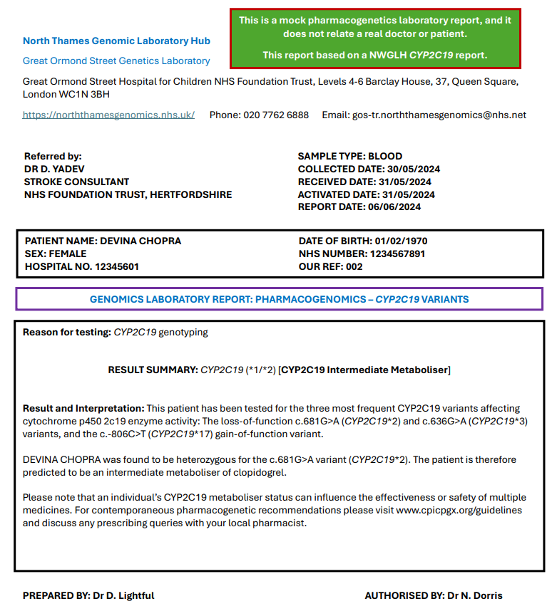
Report for Devina Chopra

Slide 25
Pharmacogenetic resources
Webpage
Mobile App
Can use this site to also explore the paediatric dashboard

Slide 26
Question 4
When treating Devina how would you interpret and action her report?
Please select ONE answer.
The patient can metabolise clopidogrel NORMALLY and the STANDARD DOSE can be prescribed.
The patient’s metabolism of clopidogrel is REDUCED and a DOSE INCREASE is required.
The patient’s metabolism of clopidogrel is REDUCED and an ALTERNATIVE drug will need to be considered.
The patient’s metabolism of clopidogrel is SIGNIFICANTLY REDUCED, and a DOSE INCREASE is required.
The patient’s metabolism of clopidogrel is SIGNIFICANTLY REDUCED and an ALTERNATIVE drug will need to be considered.
I don't know

Slide 27
Question 5
When answering question 4, which resource(s) did you use?
Local guidelines
Regional guidelines
National guidelines
Product information e.g. SmPCs
Clinical Pharmacogenetics Implementation Consortium (CPIC) guidelines
Dutch Pharmacogenetics Working Group (DPWG) guidelines
PharmGKB
GeNotes
Other, please state
None e.g., used own knowledge

Slide 28
Question 6
How would you rate your confidence in interpreting Devina’s results?
Very Poor
Poor
Fair
Good
Excellent

Slide 29
Discussion

Slide 30
Word cloud
How did you find interpreting a pharmacogenetic report?

