Slide 1
CYP2C19 Workshop
Speaker

Slide 2
Disclaimer
The pharmacogenetic reports provided are mock reports, for education and training purposes only.
A real-life pharmacogenetic report from the Genomic Laboratory Hub may look different.
There are no UK based guidelines for lansoprazole to guide UK prescribing practices…as yet…
Prescribing practices will be aligned to national e.g., NICE recommendations/SmPC with consideration to local practices, guidelines and formularies.
Hopefully, this workshop will not only help raise awareness of the pharmacogenetic resources available but ignite conversations/thoughts on how these resources can differ to our UK/local practices and what we already know about medicines.
Pharmacogenomics will not replace our clinical judgement; it is an additional tool within our medicines optimisation toolbox, we still need to consider factors such as, renal and liver function, drug interactions, co-morbidities etc…
Notes:
Image from: Group People Cartoon Images - Free Download on Freepik

Slide 3
Learning objectives
Understand the difference between genotype and phenotype
Understand the terminology of phenotype definitions
Recognise the different CYP2C19 variants
Be able to assign the correct phenotype to a genotype
Make a therapeutic recommendation using available pharmacogenetic resources.

Slide 4
Navigating through the definitions!

Slide 5
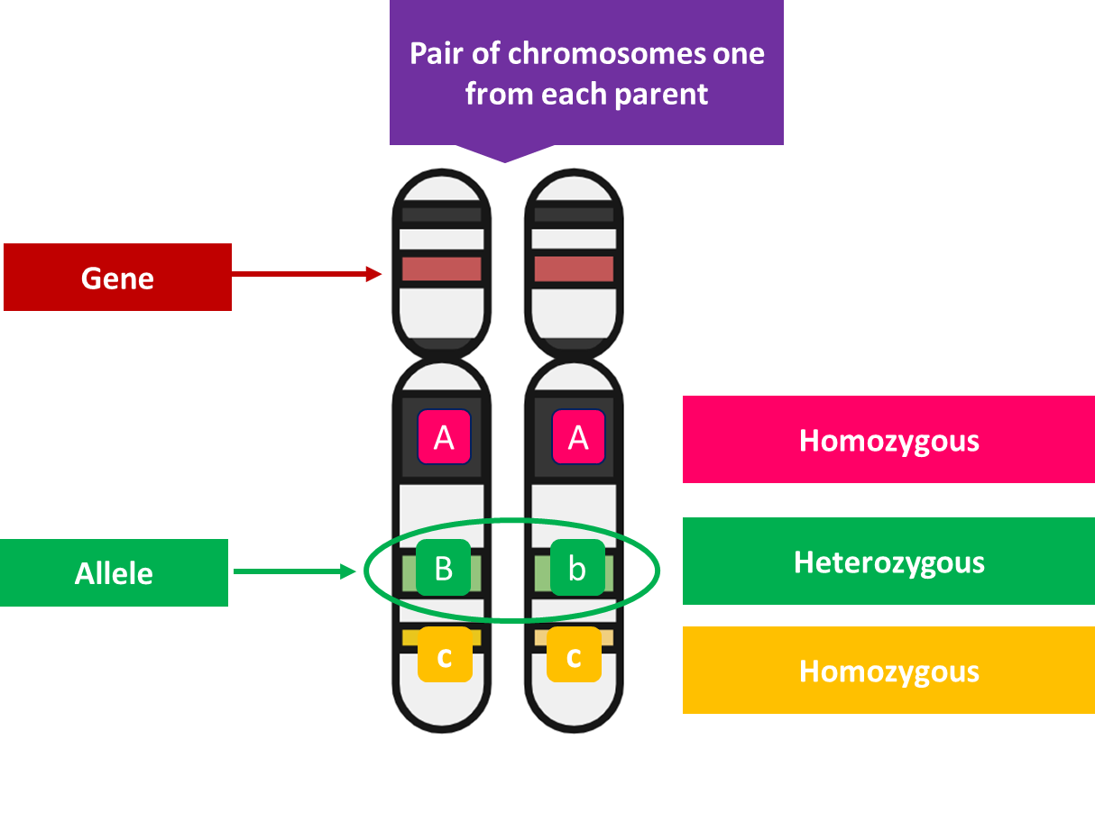
Gene, variant and allele
GENE:
A unit of inheritance and is passed from each parent to a child.
This gene contains information on how to build a protein.
VARIANT:
A site where the part of the gene you are looking at is different to the reference genome
ALLELE:
An allele is a specific version of a gene.
Each person inherits two alleles of a gene, one from each parent.
Notes:
Gene: In humans we have approximately 20,000 protein coding genes. Which represents 1.5% of our entire human genome.

Slide 6
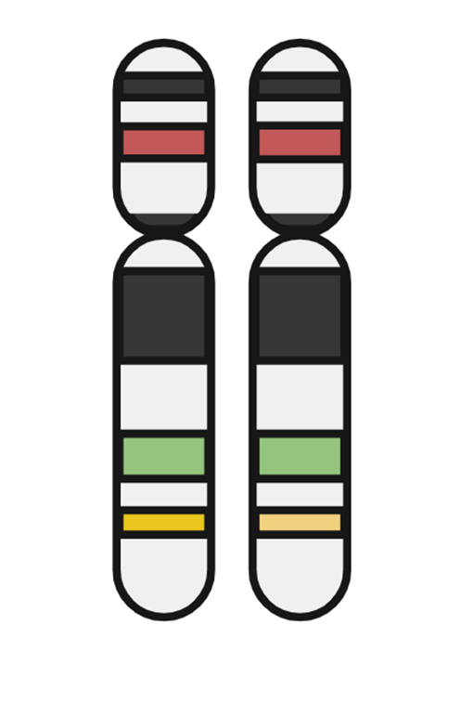
Haplotype and diplotype
A HAPLOTYPE refers to the combination or patterns in which alleles can be found in individuals.
A haplotype can be a single gene allele or a group of alleles which can be found together.
Within pharmacogenetics we are interested in the DIPLOTYPE which is a combination of TWO haplotypes because this will determine the overall phenotype within pharmacogenetics e.g., co-dominant trait.
HAPLOTYPE
*1
*1
*3
DIPLOTYPE

Slide 7
Genotype
GENOTYPE: the set of alleles which have been inherited and will determine a given characteristic and will determine what will be expressed.
In pharmacogenetics a STAR (*) ALLELE NOMENCLATURE SYSTEM is used
GENETIC VARIANT
Human Genome Variation Society nomenclature | Star (*) Allele Nomenclature
c.991A>G (reference) | CYP2C19*1
c.332-23A>G c.681G>A | CYP2C19*2
c.636G>A | CYP2C19*3
c.-806C>T | CYP2C19*17

Slide 8
Phenotype
With pharmacogenetics the genotype will determine how much enzyme will be expressed and the expression is known as PHENOTYPE = the observable trait.
GENETIC VARIANT |  | EFFECT
Human Genome Variation Society nomenclature | Star (*) Nomenclature | Phenotype
c.991A>G (reference) | CYP2C19*1 | Normal function
c.332-23A>G c.681G>A | CYP2C19*2 | Loss of function
c.636G>A | CYP2C19*3 | Loss of function
c.-806C>T | CYP2C19*17 | Gain of function

Slide 9
Genotype → Phenotype
DIPLOTYPE | FUNCTIONALITY of the ALLELE | PHENOTYPE | Effect on a DRUG administered in its ACTIVE form
*17 / *17 | Two gain of function alleles | Ultrarapid metabolizers | Decreased plasma drug concentration; greater risk of therapeutic failure
*1/*17 | one normal + gain of function | Rapid metabolizer | Decreased plasma drug concentration; increased risk of therapeutic failure
*1 / *1 | Two normal functional alleles | Normal metabolizer | Normal drug metabolism with minimal toxicity
*1/*2 *1/*3 *2/*17 *3/*17 | One normal function allele + one loss of function allele OR One gain of function allele + one loss of function allele | Intermediate metabolizer | Potential reduced or increased plasma drug concentrations; possible increased or reduced efficacy with/without potential toxicity
*2/*2 *3/*3 *2/*3 | Two loss of function alleles | Poor metabolizer | Increased plasma concentration; increased toxicity and possible increased efficiency

Slide 10
CYP2C19 phenotype by ancestry
Ultrarapid/Rapid
Normal
Intermediate/likely intermediate
Poor/Likely Poor
Lee CR, et al. Clin Pharmacol Ther. 2022;112(5):959-967.

Slide 11
Resources
What’s out there?

Slide 12
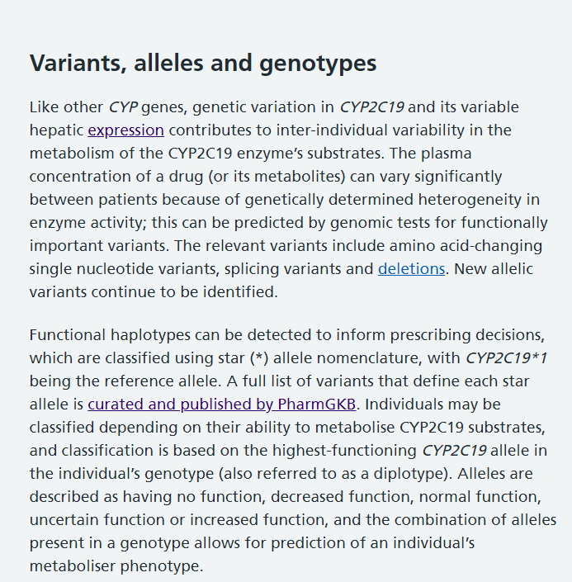
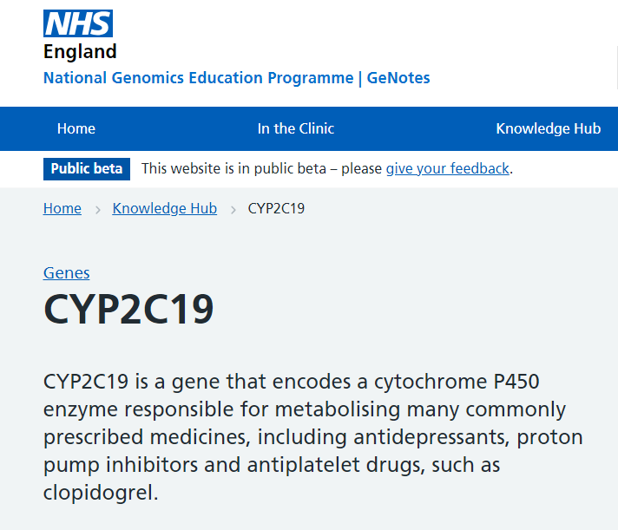
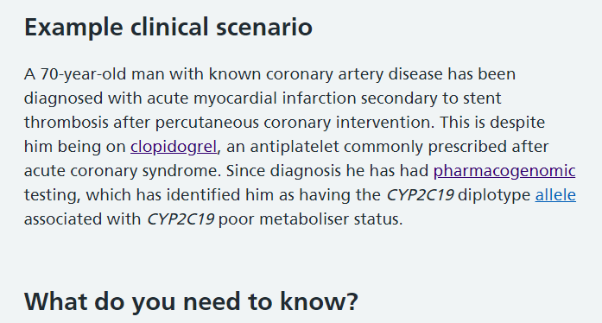
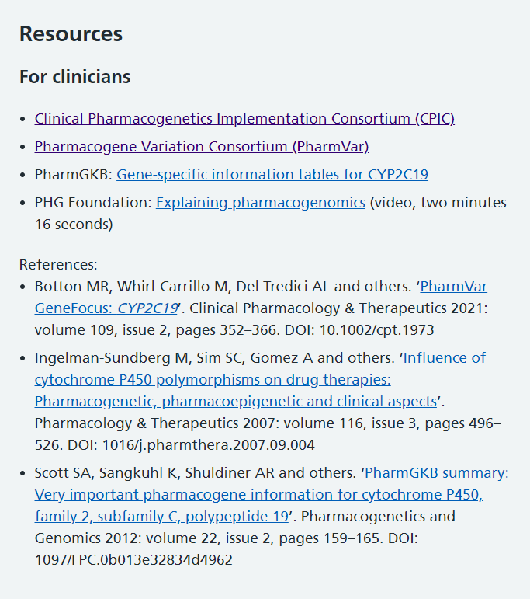
Resources – for an overview of a gene
GeNotes
Just in time resources which also signposts you to CPIC and other useful papers and resources.
A quick overview of the information with an example clinical scenario.
PIL available - Cincinnati Children’s Hospital

Slide 13
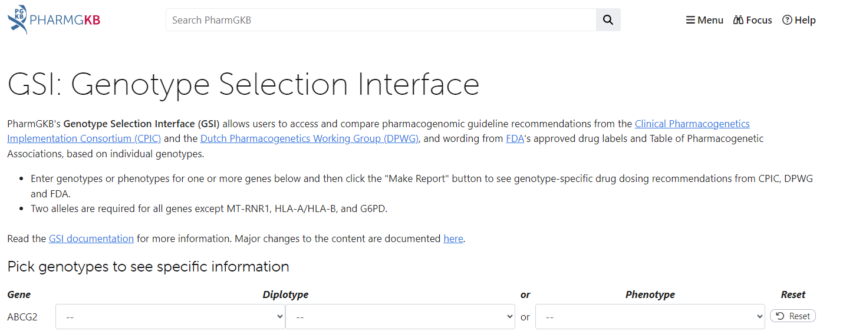
Resources – to aid interpretation
Published guidelines
Clinical Pharmacogenetics Implementation Consortium (CPIC) Guidelines – CPIC (cpicpgx.org)
Dutch Pharmacogenetics Working Group (DPWG)
Production information
Summary of Product Characteristics
BNF
Online tools/apps – to aid interpretation
PharmGKB
DNA-Driven Rx (pharmgkb.org) or can use
GSI: Genotype Selection Interface (pharmgkb.org)

Slide 14
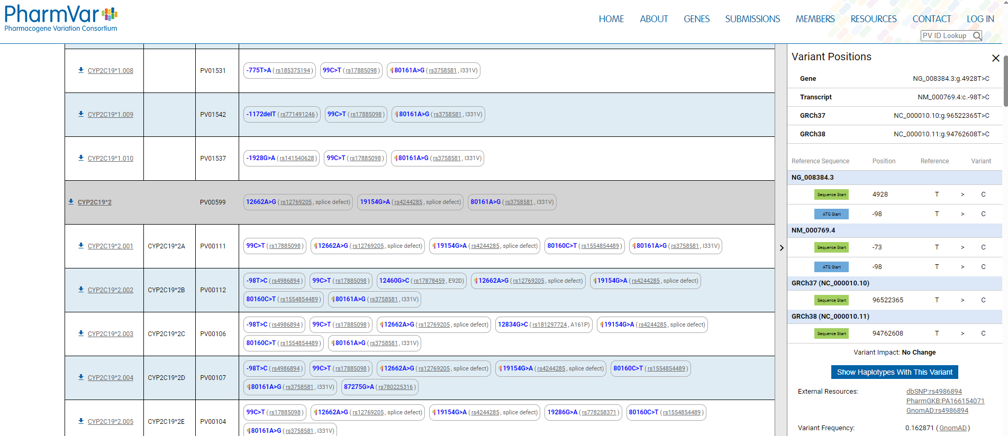
Resources – for detailed genotype information
For those more familiar with pharmacogenetics or embarking on research projects and developing national guidelines – PharmVar is another resource for detailed genotype data.
Not needed for interpretation for the case studies but to raise awareness this site exists, and research papers may refer to it.

Slide 15
Case study 1
Lansoprazole

Slide 16
Patient Akiko Suzuki
Patient Akiko Suzuki was treated on a stroke unit and her consultant Dr Yardev requested a CYP2C19 pharmacogenetic test.
Dr Yadev requested a CYP2C19 pharmacogenetic test to check if clopidogrel was the right treatment for his patient and he uses the results to manage Akiko’s dual anti-platelet treatment.
3 months later Akiko visits his GP, Dr Jones, for a follow-up and notices that a proton pump inhibitor should be considered as per the National Clinical Guideline for Stroke.
On Akiko notes, Dr Jones notices that a CYP2C19 test result is available and would like to use the results before prescribing lansoprazole and he asks his pharmacist to help interpret the report.

Slide 17
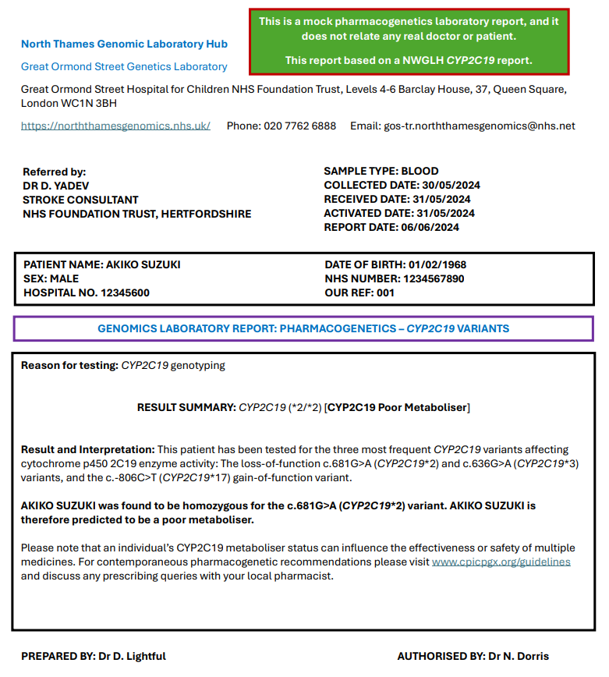
Report for Akiko Suzuki

Slide 18
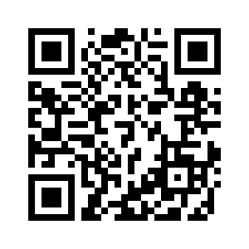
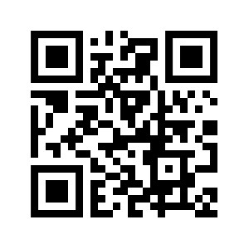
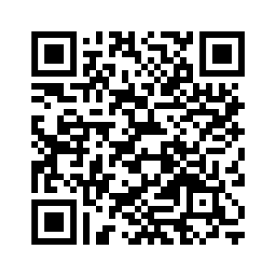
Pharmacogenetic resources
Webpage
Mobile App
Can use this site to also explore the paediatric dashboard

Slide 19
Question 1
When treating Akiko how would you interpret and action his report?
Please select ONE answer.
The patient can metabolise lansoprazole NORMALLY and the STANDARD DOSE can be prescribed.
The patient’s plasma concentration of lansoprazole is INCREASED and STANDARD DOSE can be prescribed.
The patient’s plasma concentration of lansoprazole is SIGNIFCANTLY INCREASED and STANDARD DOSING can be initiated and if treatment needed for >12 weeks, a 50% dose reduction can be considered.
The patient’s plasma concentration of lansoprazole is REDUCED, and STANDARD DOSING can be initiated
The patient’s plasma concentration of lansoprazole is SIGNIFICANTLY REDUCED and an INCREASED DOSE will need to be prescribed
I don't know

Slide 20
Question 2
When answering question 2, which resource(s) did you use?
Local guidelines
Regional guidelines
National guidelines
Product information e.g. SmPCs
Clinical Pharmacogenetics Implementation Consortium (CPIC) guidelines
Dutch Pharmacogenetics Working Group (DPWG) guidelines
PharmGKB
GeNotes
None e.g., used own knowledge
Other

Slide 21
Question 3
How would you rate your confidence in interpreting Akiko’s results?
Very Poor
Poor
Fair
Good
Excellent

Slide 22
Case study 2
Lansoprazole – optional if time available

Slide 23
Patient Natoya Hudson
Natoya visits her local GP, and you have been asked to review her in your prescribing clinic.
Natoya explains that she has symptoms of heartburn and bloating which is worse after she eats or lies down.
After taking a full clinical and medical history, you diagnose GORD and decided to prescribe lansoprazole.
Natoya has had a CYP2C19 testing from a pharmacogenetic clinical study you helped enrol into.
You double check her CYP2C19 results before prescribing lansoprazole.

Slide 24
Report for Natoya Hudson

Slide 25
Pharmacogenetic resources
Webpage
Mobile App
Can use this site to also explore the paediatric dashboard

Slide 26
Question 4
When treating Natoya how would you interpret and action her report?
Please select ONE answer.
The patient can metabolise lansoprazole NORMALLY and the STANDARD DOSE can be prescribed.
The patient’s plasma concentration of lansoprazole is INCREASED and STANDARD DOSE can be prescribed.
The patient’s plasma concentration of lansoprazole is SIGNIFCANTLY INCREASED and STANDARD DOSING can be initiated and if treatment needed for >12 weeks, a 50% dose reduction can be considered
The patient’s plasma concentration of lansoprazole is REDUCED, and STANDARD DOSING can be initiated
The patient’s plasma concentration of lansoprazole is SIGNIFICANTLY REDUCED and an INCREASED DOSE will need to be prescribed
I don't know

Slide 27
Question 5
When answering question 2, which resource(s) did you use?
Local guidelines
Regional guidelines
National guidelines
Product information e.g. SmPCs
Clinical Pharmacogenetics Implementation Consortium (CPIC) guidelines
Dutch Pharmacogenetics Working Group (DPWG) guidelines
PharmGKB
GeNotes
Other, please state
None e.g., used own knowledge

Slide 28
Question 6
How would you rate your confidence in interpreting Natoya’s results?
Very Poor
Poor
Fair
Good
Excellent

Slide 29
Discussion

Slide 30
Word cloud
How did you find interpreting a pharmacogenetic report?

